Slide 1

Omics research of aging-related conditions in population-based studies
Yang Pan, PhD
Assistant Professor
Department of Medicine

Slide 2

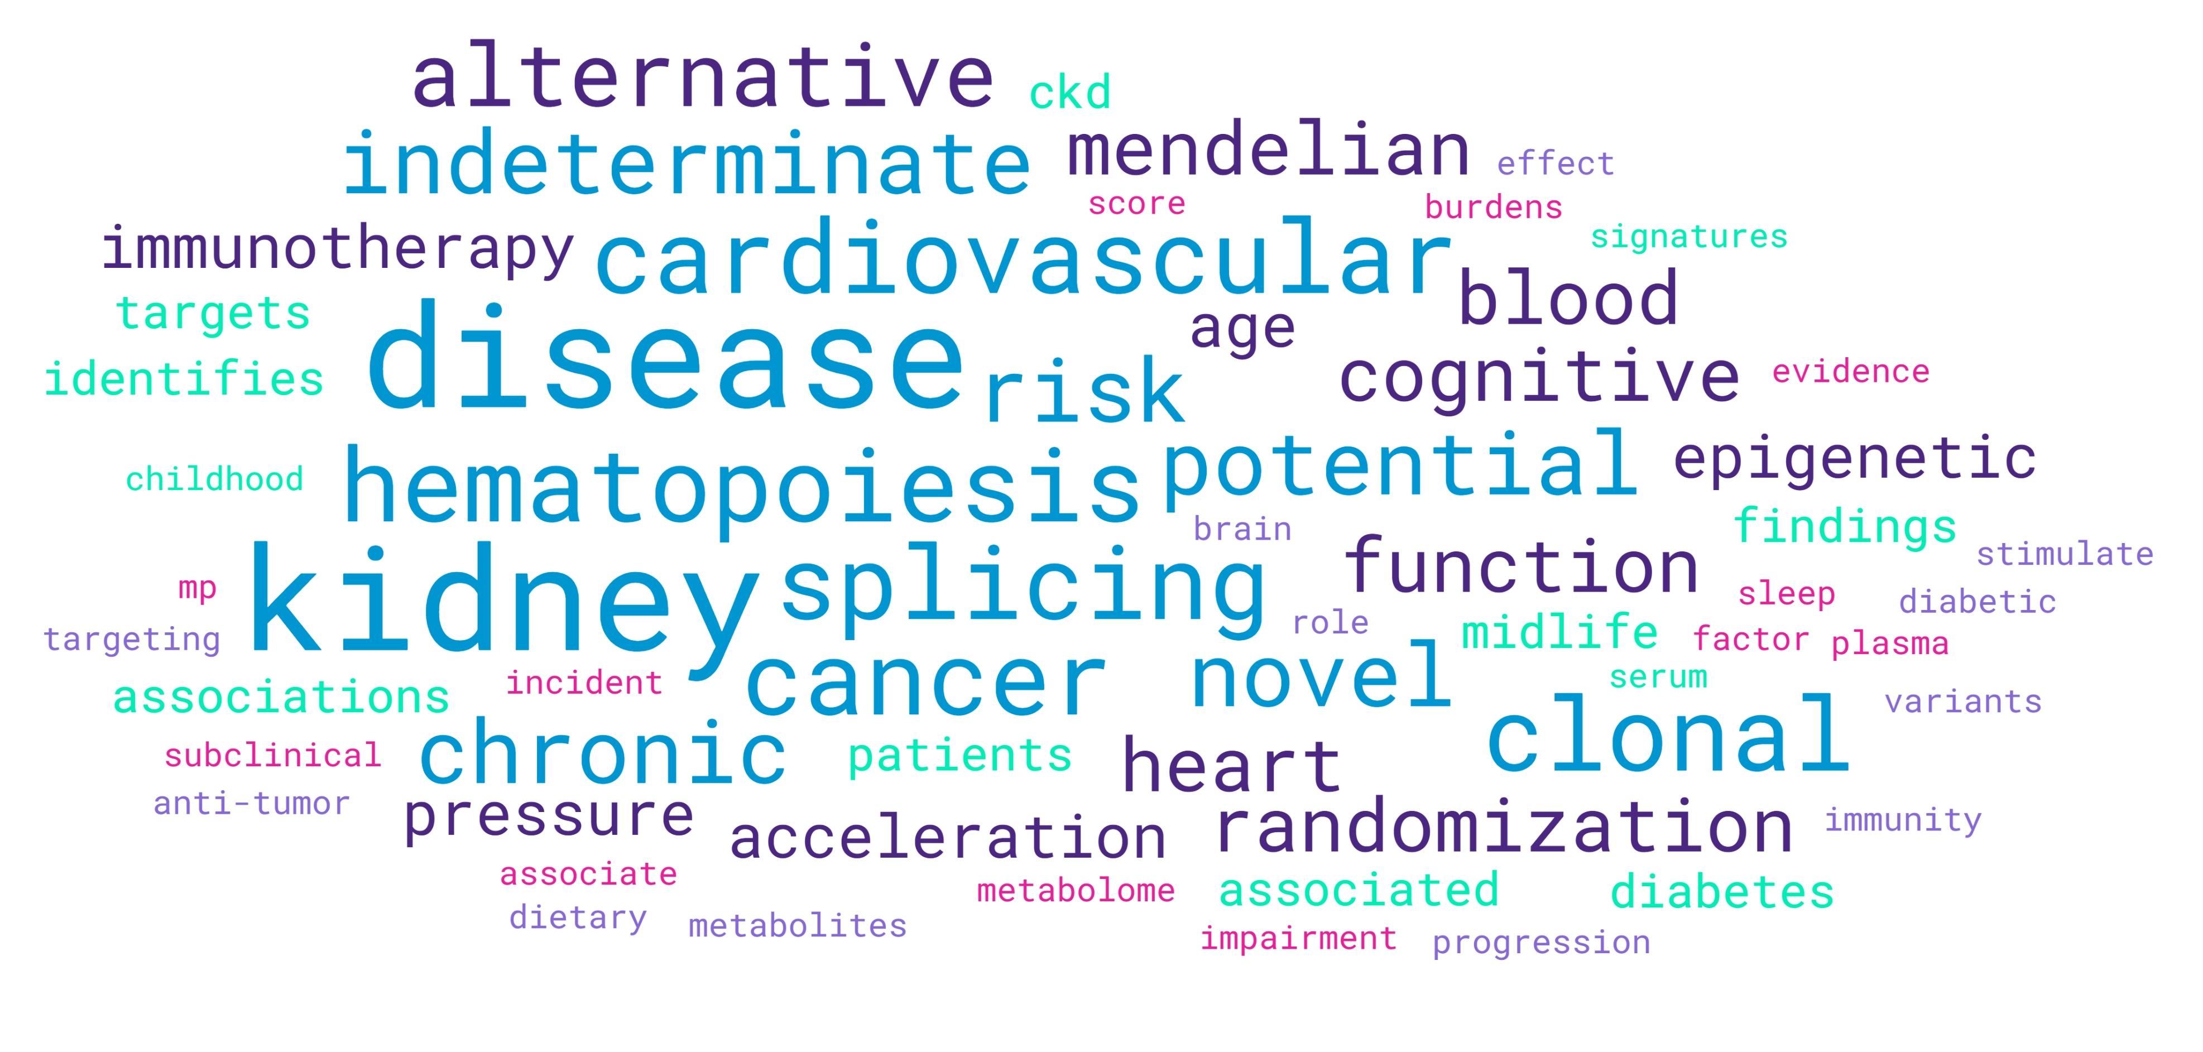


Educational background and research interests
Ph.D. in Bioinformatics (2020), University of California, Los Angeles
Postdoc in Epidemiology (2022), Tulane University
Postdoc in Epidemiology (2025), University of Illinois Chicago
R00 Award on “Associations of Mitochondrial DNA Alterations with Alzheimer's Disease Related Brain Health”
*Based on my publications over the past five years
Notes:
Various aging and aging related diseases, and molecular features of aging

Slide 3
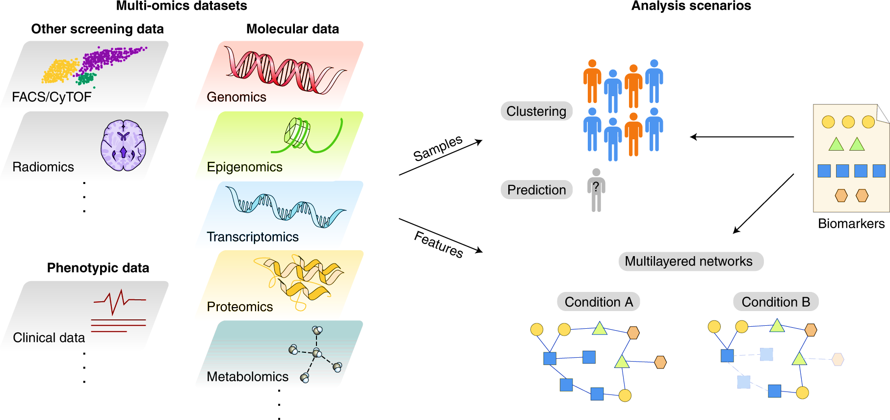

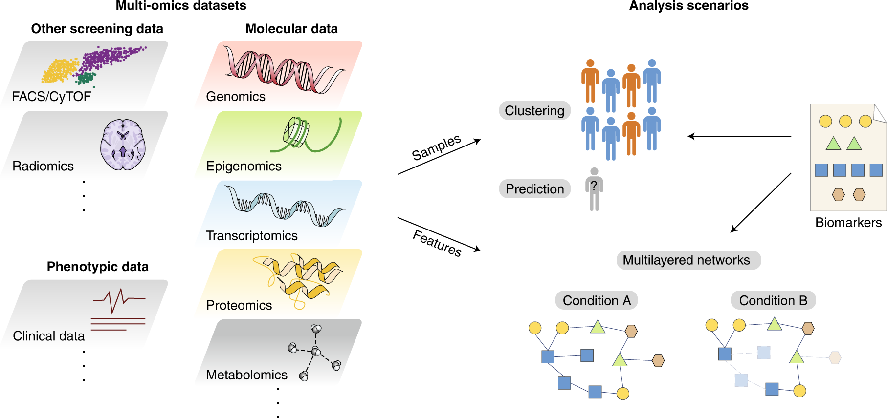
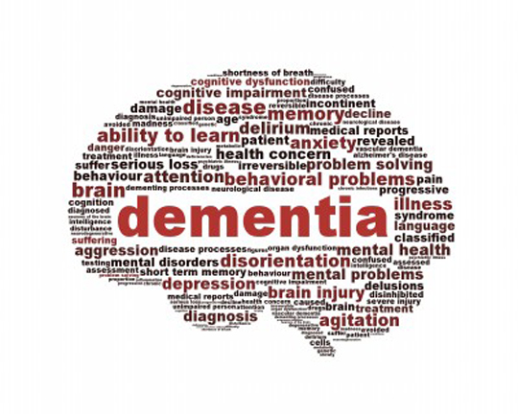
Omics-based approach to molecularly characterize features of age-related conditions in population-based studies
Omics data
Cohorts/biobanks
Aging-related
conditions
My research aims to molecularly characterize age-related conditions in population-based studies to support targeted prevention and treatment.
Carton elements adopted from Tarazona, et al. Nat Comput Sci (2021)
Notes:
Chronologic age is the dominant risk factor for major chronic diseases.
Overall theme of my research is to use omics-based approach

Slide 4
Aging-related molecular features in chronic diseases
Part 1. Clinical and molecular consequences of clonal hematopoiesis of indeterminate potential (CHIP) in chronic kidney disease (CKD)
Part 2. Epigenetic aging and brain and heart health in midlife
Notes:
Here I will present my recent work on two age-related molecular changes.

Slide 5
Part 1. Clinical and molecular consequences of clonal hematopoiesis of indeterminate potential (CHIP) in CKD
Prospective associations of CHIP with CVD in CKD
Protein signatures of CHIP in CKD
Notes:
Ongoing work

Slide 6
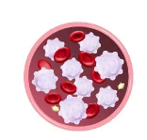
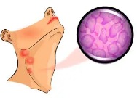
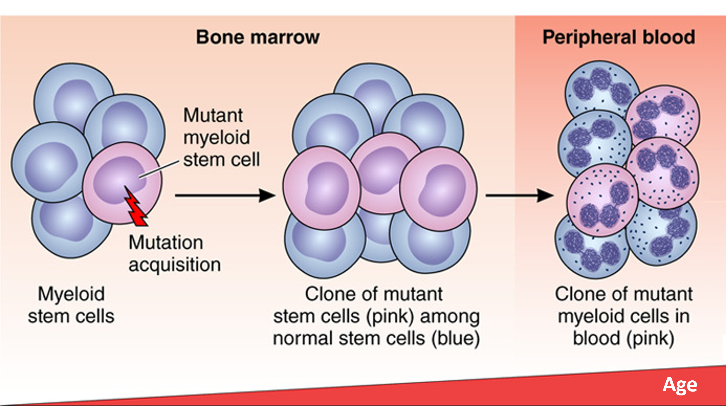
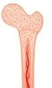
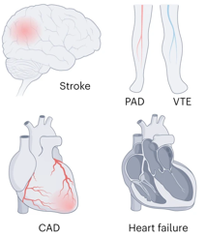
Clonal hematopoiesis of indeterminate potential (CHIP) and aging
Hematologic Cancers
Leukemia
Lymphoma
Myeloma
Since
2014
Cardiovascular Diseases
Age
Libby et al. Circulation. (2018)
Khetarpal et al. JACC (2019)
Vlaesschaert et al. Nat Rev Nephrol (2024)
Notes:
CHIP is first described as a subclinical blood condition in elderly individuals, characterized as clonal expansions of certain blood stem cell clones in absence of clinical hematologic diseases.
About 10 years later, using next gen sequencing, recurrent cancer driver mutations were identified as driver of these clonal expansion.
With continuous advance of NGS, gemics sequencing of blood cells has been employed in population-based research, CHIP can be reliably measured and found as is prevalent among older population, in over 10% of those with age 65. Besides association with blood cancers,
This lead to several findings in around 2014, CHIP was found associated with 11 fold increased risk with HC, and more surprisingly nearly 2 fold in CHD.

Slide 7
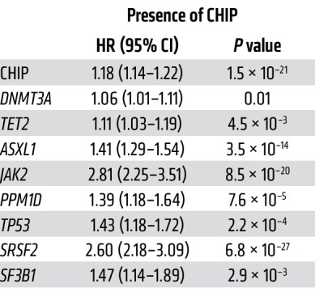
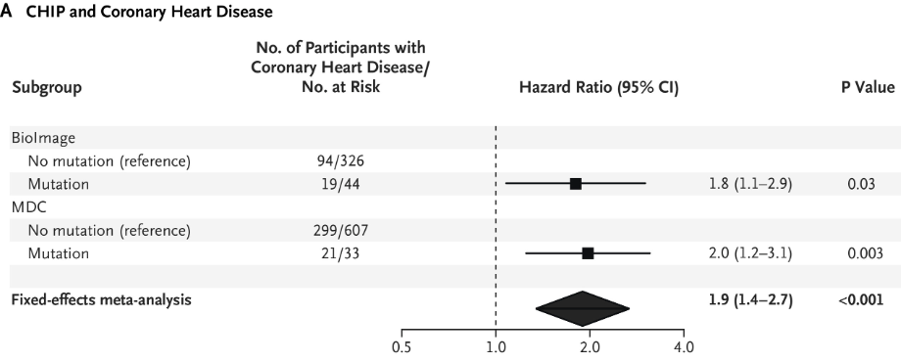
CHIP is CVD in the general population
NEJM paper 2017 (CHD)
UK Biobank study 2023 (CVD)
CHIP mutations commonly occur in DNMT3A, TET2, ASXL1, and JAK2.
Non-DNMT3A CHIP is typically more deleterious.
Age
Jaiswal S, Natarajan P, Silver AJ, et al. N Engl J Med. 2017
Yu Z, Fidler TP, Ruan Y, et al. J Clin Invest. 2023
Notes:
In a large landmark study, CHIP found associated with near 2 fold increased risk of CHD. In a biobank study of composite CVD outcome, association confirmed but with smaller effect sizse
Such mutations typically occur in DNMT3A, TET2, ASXL1, and JAK2.

Slide 8
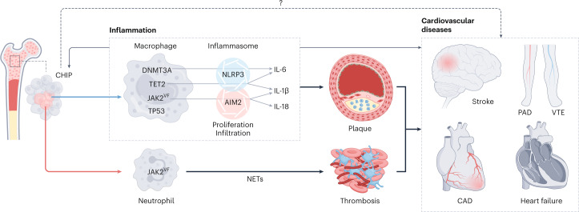
CHIP, CVD and inflammation
Age
Nakao T, Natarajan P. Nat Cardiovasc Res. (2022)

Slide 9
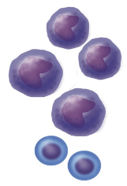
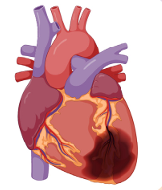
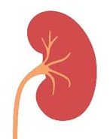


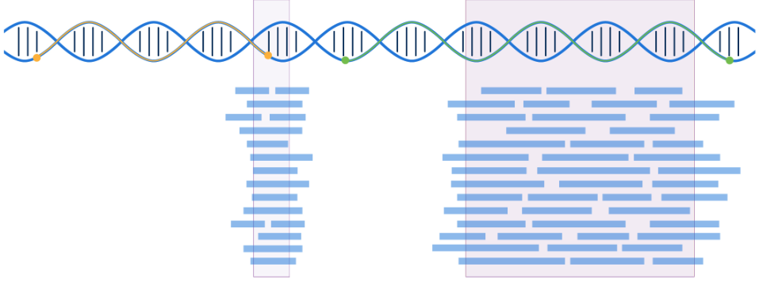
Investigation of CHIP in Patients with CKD
The objective of this study is to examine the association of CHIP with incident CVD in CKD patients from four large epidemiological studies
CKD
CHIP
CVD
Inflammation
Four Prospective Cohorts (N=5,772)
Targeted CHIP Gene Sequencing
Composite of HF, MI, Stroke, and PAD
Deep coverage (~500X)
AASK
CanPREDDICT

Slide 10
Study populations
 | CRIC | AASK | CanPREDDICT | BioVU
N | 2,012 | 206 | 1,121 | 2,445
Age, mean ± SD | 70 ± 4 | 61 ± 6 | 68 ± 13 | 63 ± 14
Female, % | 41 | 35 | 37 | 53
Non-white, % | 53 | 100 | 9.7 | 13.9
eGFR, mean ± SD | 46 (16) | 48 (12) | 29 (10) | 48 (19)
Hypertension, % | 93 | 100 | 98 | 92
Diabetes, % | 55 | 0 | 47 | 30

Slide 11
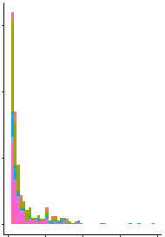
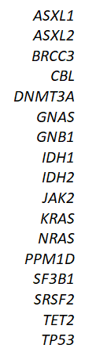
CHIP in CKD patients
CHIP prevalence ranged from 19% to 28% across CKD patient cohorts.
Distribution of CHIP driver gene variants, CRIC
150
100
50
0
CHIP Variant Count
Study | CHIP, % | Non-DNMT3A CHIP, %
AASK | 27 | 11
CanPREDDICT | 26 | 16
CRIC | 28 | 13
BioVU | 19 | 10
0 0.25 0.50 0.75 1.0
Variant allele frequency
Vlaesschaert, Pan, et al. J Am Soc Nephrol. 2025

Slide 12
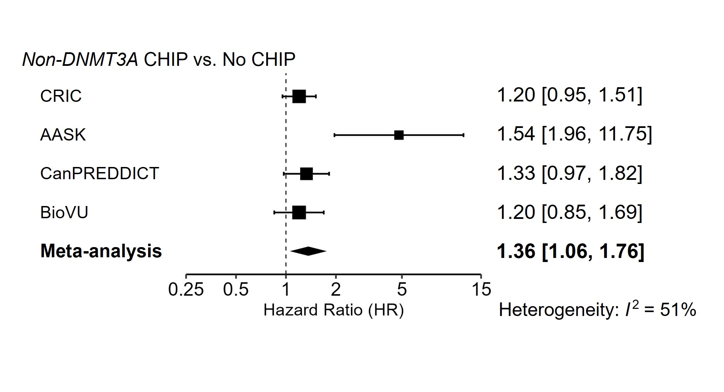
Associations of CHIP with a composite CVD endpoint in patients with CKD
Pan, Vlaesschaert et al. J Am Soc Nephrol. 2025

Slide 13
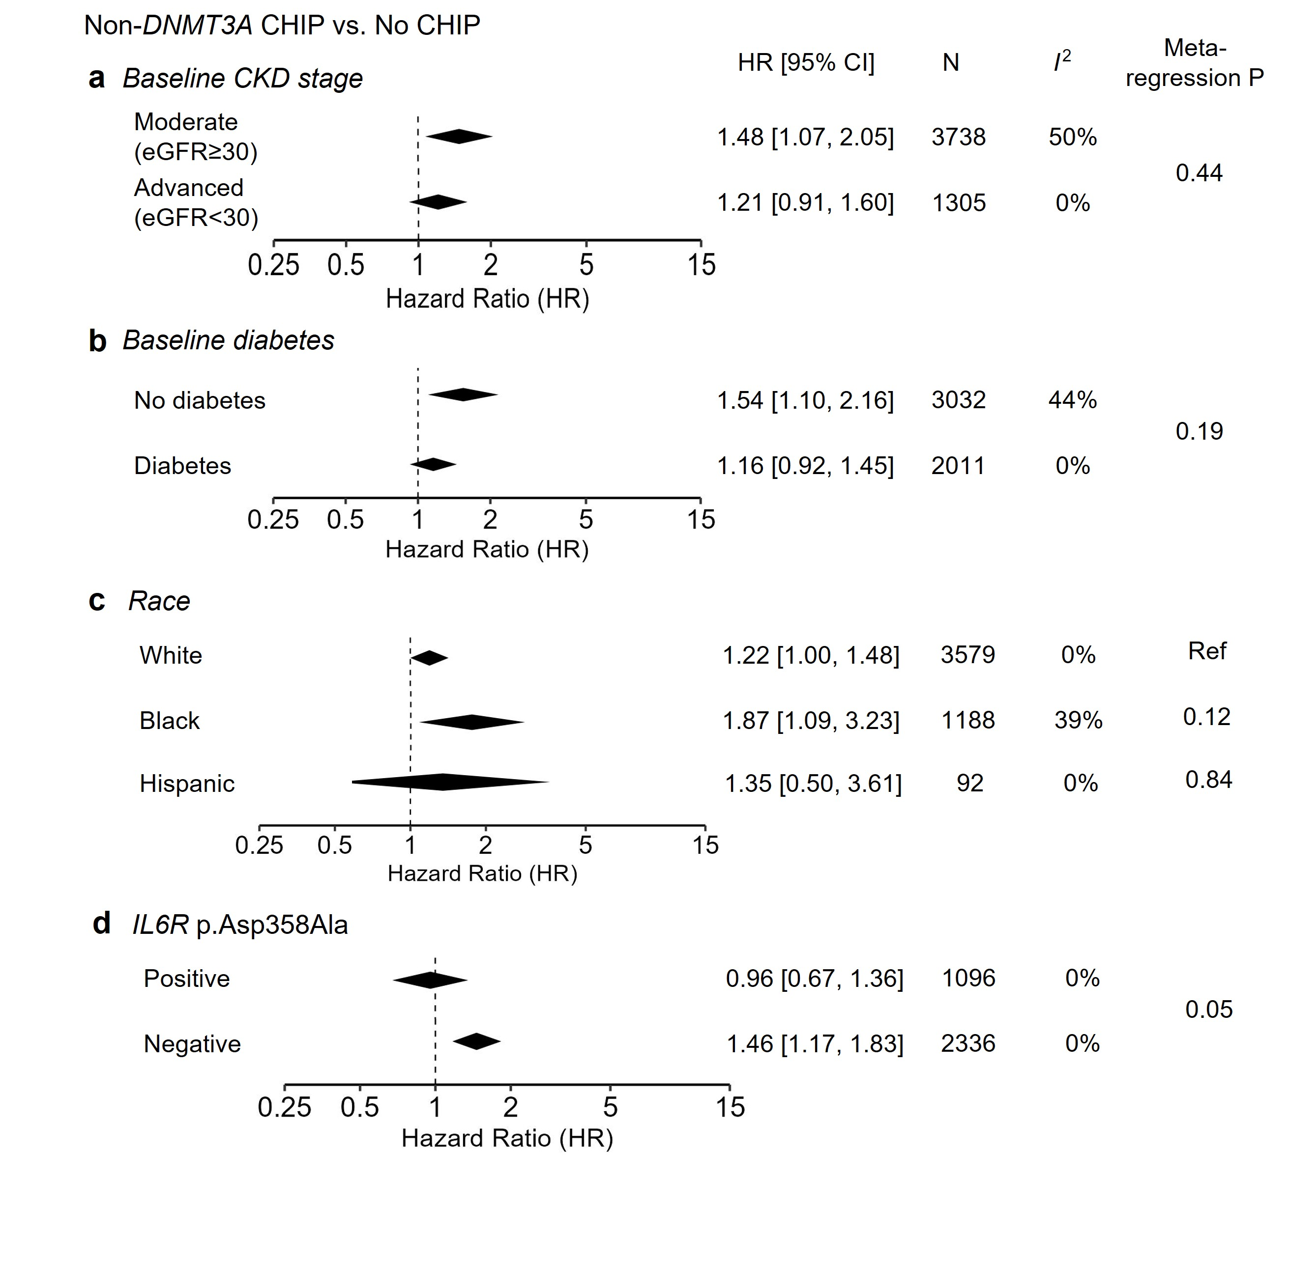
Genetic interleukin 6 signaling deficiency attenuates non-DNMT3A CHIP’s effect on CVD risk in CKD patients
HR [95% CI]
N
I ²
Meta-regression P
Pan, Vlaesschaert et al. J Am Soc Nephrol. 2025
Notes:
interleukin-6 signaling, an inflammatory pathway up-regulated by CHIP and known to promote cardiovascular disease
A commonly occurring (allele frequency 30–40%) variant in IL-6 receptor gene, IL6R p. Asp358Ala, disrupts IL-6 signaling
Those without genetically reduced interleukin-6 signaling (non-carriers of IL6R p.Asp358Ala) had worse disease (HR 1.46; 95% CI 1.17– 1.83, P_{subgroup difference} = 0.05)
was in line with findings from the general population.

Slide 14
Summary
In patients with CKD, non-DNMT3A CHIP was associated with CVD with an effect size similar to that reported in the general population.
The protective effect of IL6R p.Asp358Ala on non-DNMT3A CHIP CVD risk, suggesting a role of inflammatory pathway. Proinflammatory cytokine blockade may mitigate CHIP-related effect.
What’s next:
Identify upstream risk factors and downstream effectors of CHIP in CKD
Define CHIP subtype-specific effects
Notes:
What’s next in order to develop precision prevention strategies,
Underlying mechanisms, including

Slide 15
Part 1. Clinical and molecular consequences of clonal hematopoiesis of indeterminate potential (CHIP) in CKD
Prospective associations of CHIP with CVD in CKD
Protein signatures of CHIP in CKD
Notes:
Ongoing work

Slide 16
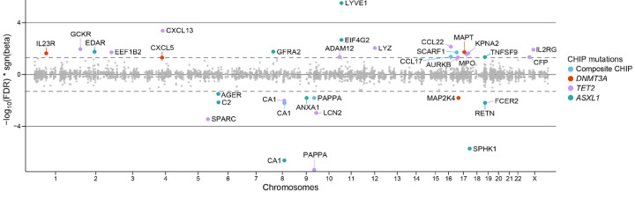
Molecular features of CHIP
Molecular changes associated with CHIP may provide sights into key mediators/effectors that improve disease classification or risk estimation
A recent preprint reported a large meta-analysis (n>20,000) in the general population found 32 proteins associated with CHIP
Protein signatures capturing interactions and combinatory effects remain unexplored, especially in CKD
Zhi, Y, et al. bioRxiv (2024).
Notes:
Just give you a quick intro of latest studies on CHIP’s moelduclar consequences.
CHIP GWAS, epigenetics, aminal models, study focusing on blood protein impact is lacking.
Only one preprint so far. Yu Zhi paper, but no paper has been on CKD

Slide 17

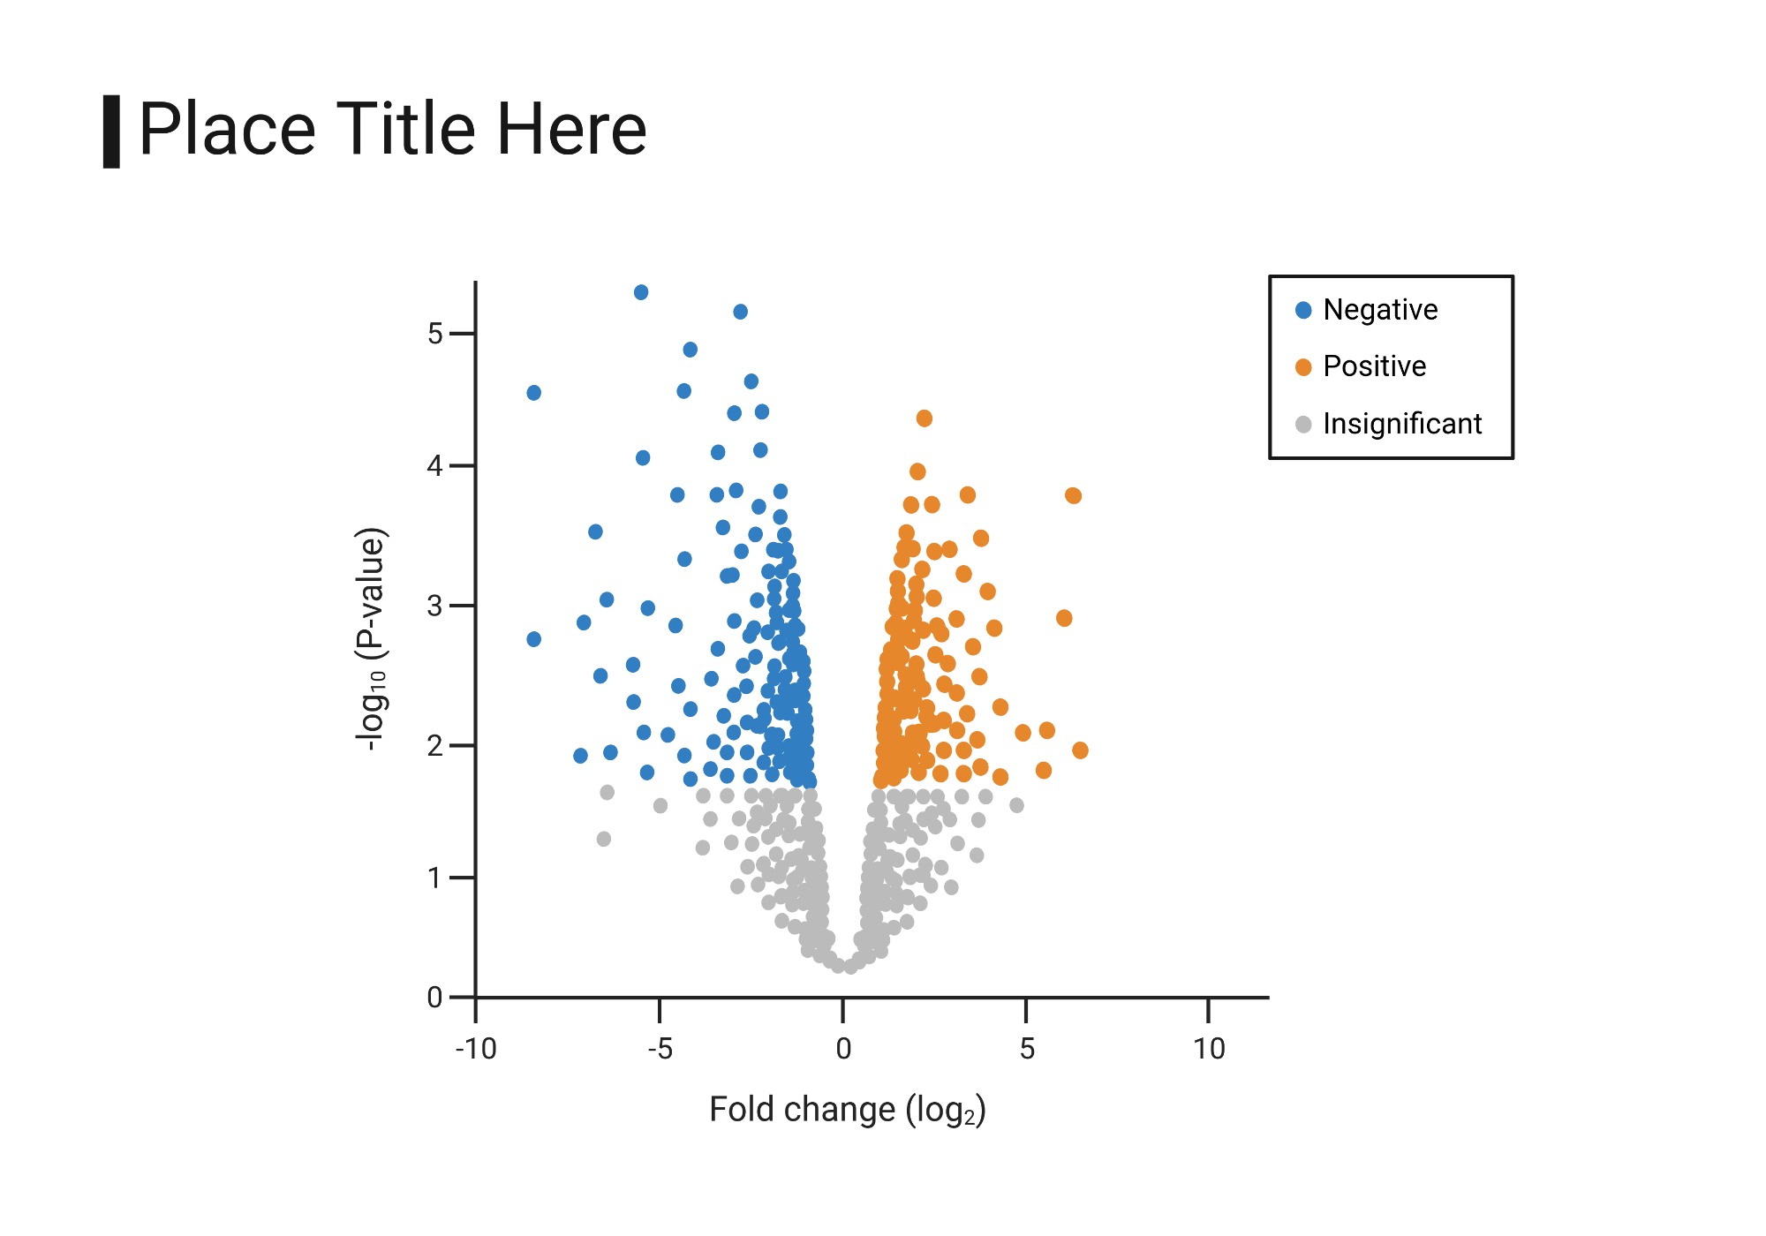
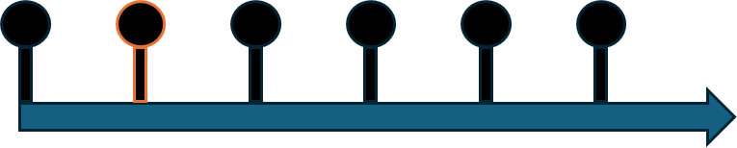
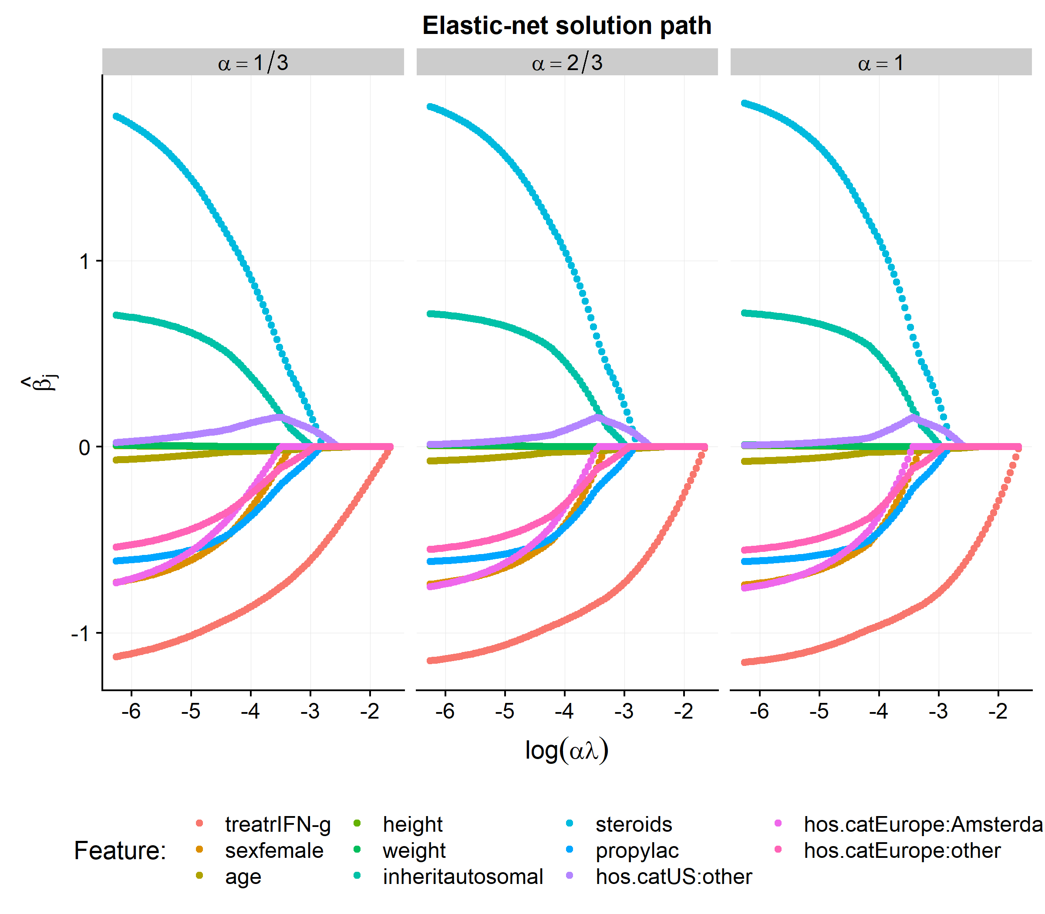
Study design
CRIC study timeline
Single protein
Logistic regression
Y1
Proteomics
SomaScan proteomics profiling
(N protein=4,830)
Cross-sectional
(N=977)
Identified proteins
Y0
Y1
Y2
Y3
Y4
Y5
Protein signature
Elastic net regression
Evaluation
External replication
Mediation analysis
Mendelian Randomization
CHIP
+/- 1 year of Y1
High-depth targeted sequencing
(CHIP subtypes)
Unpublished data

Slide 18
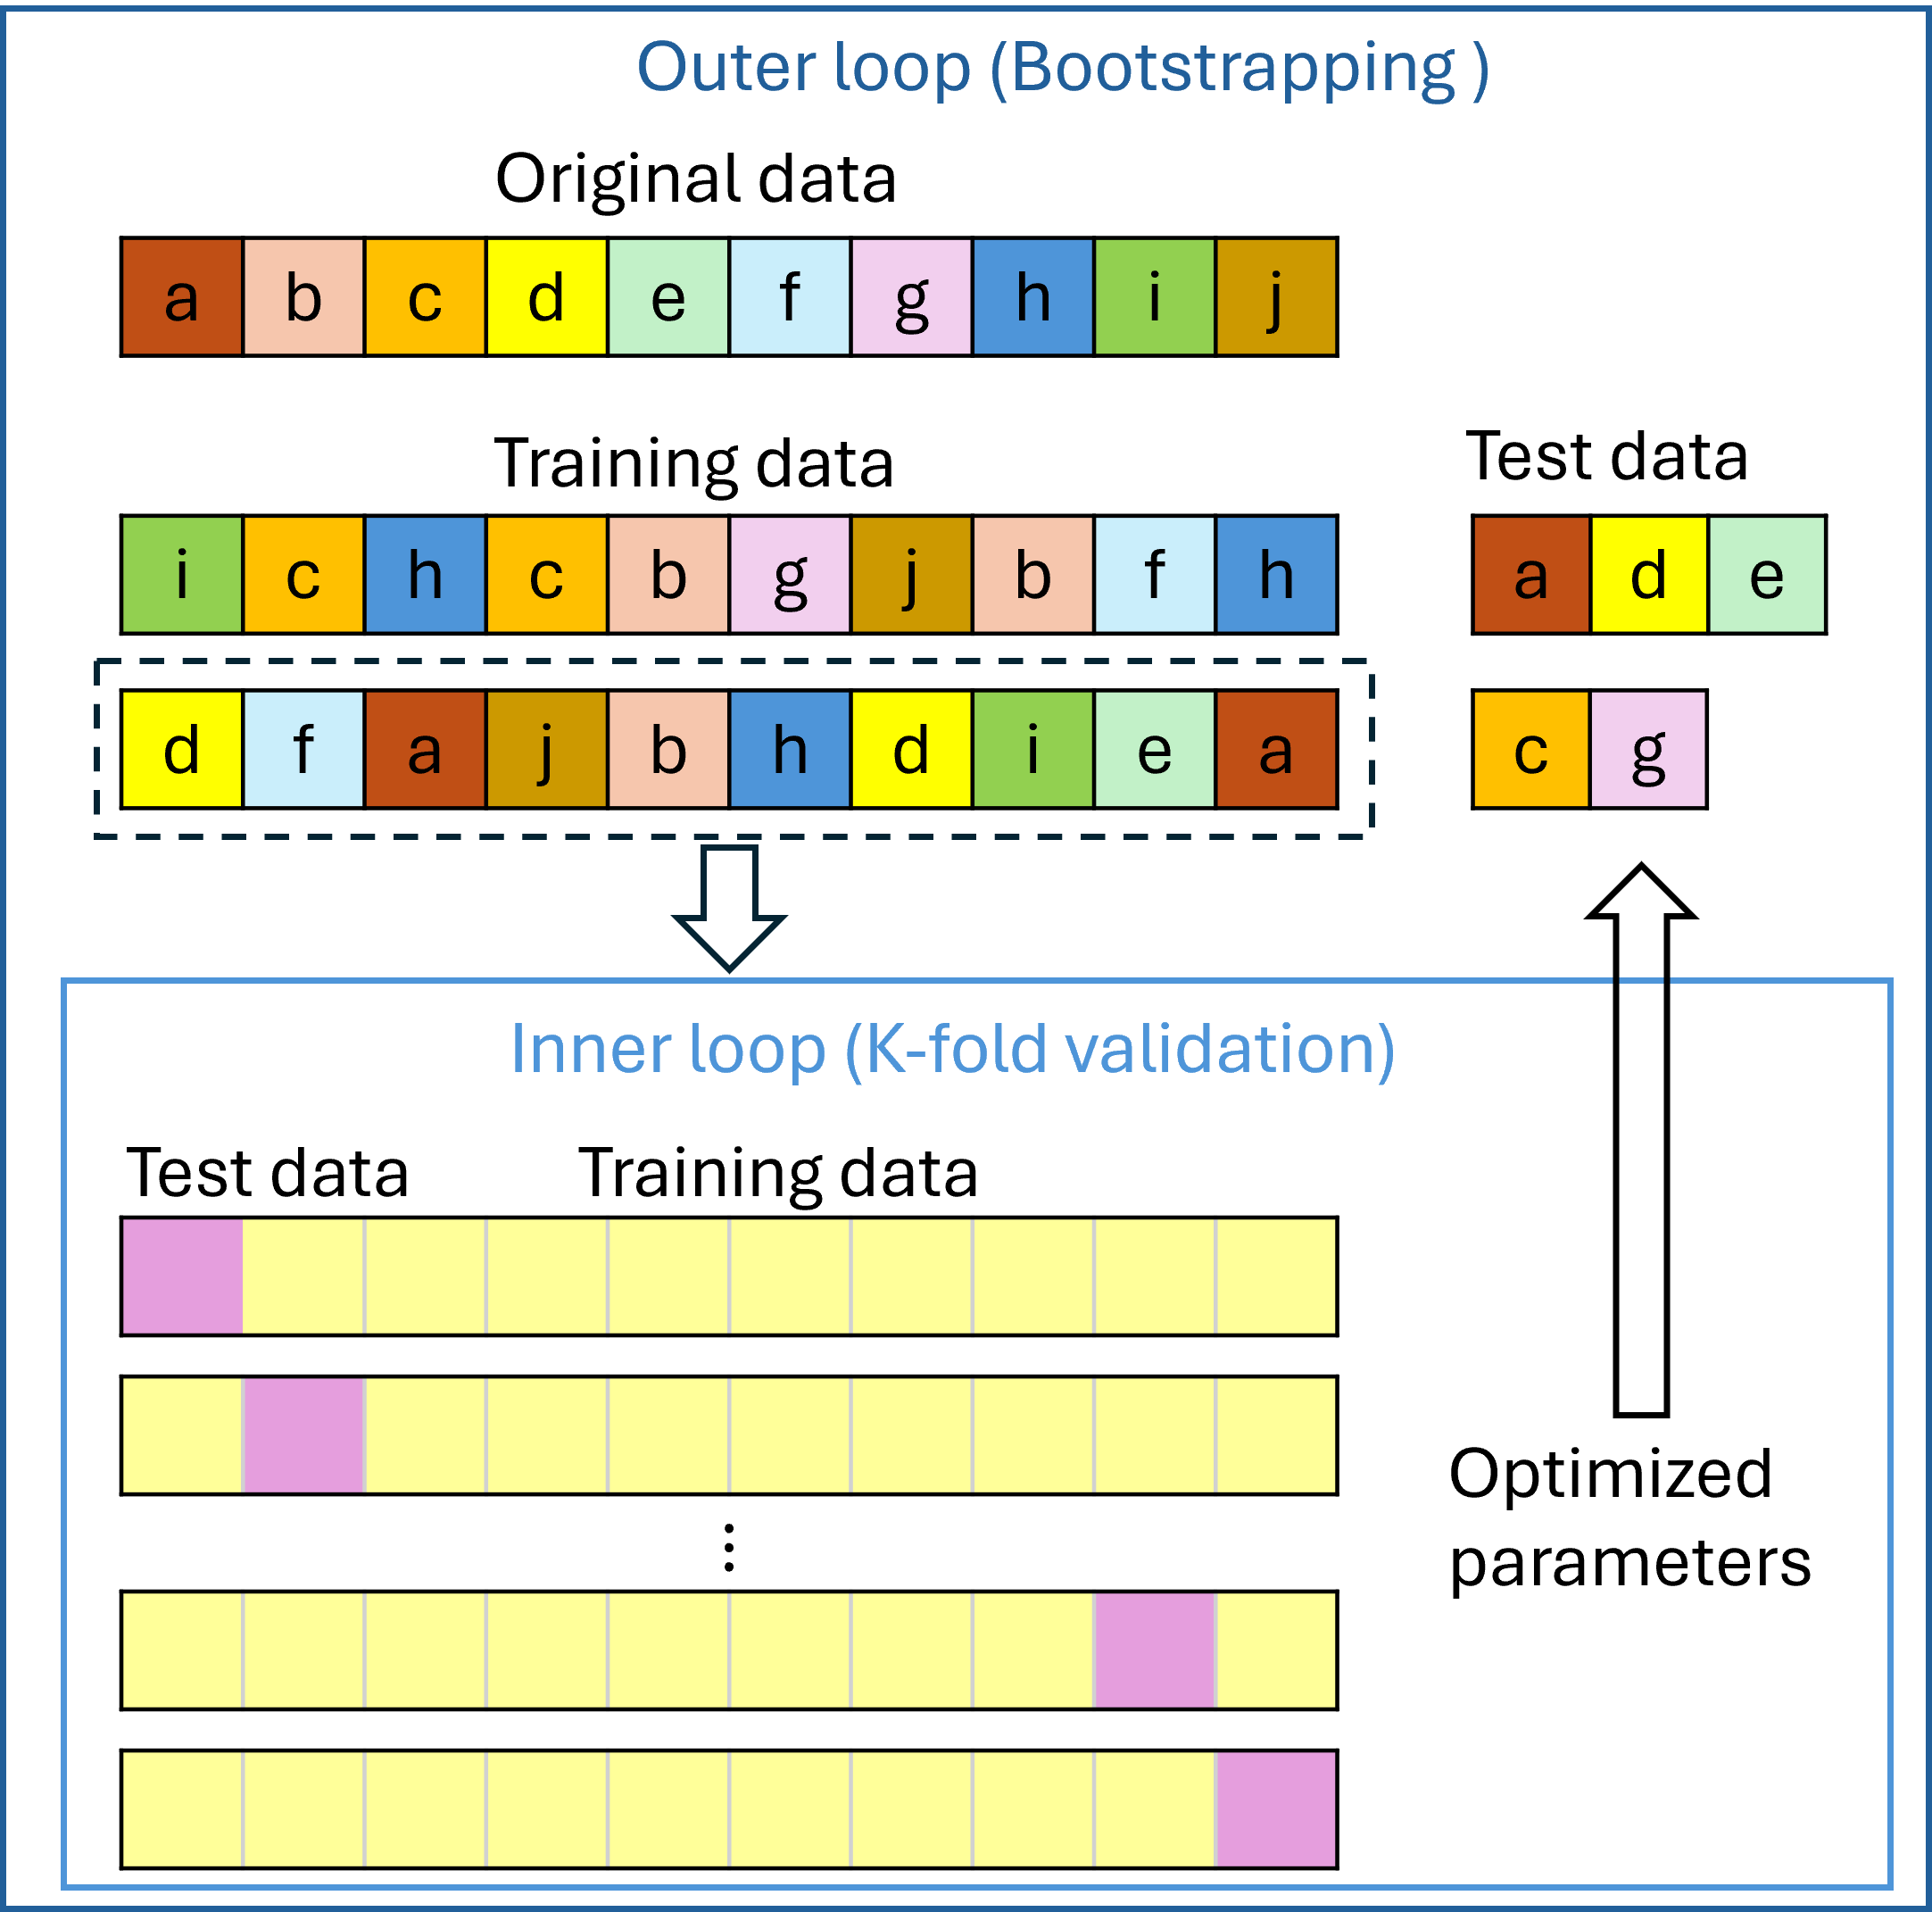
Developing protein signatures of CHIP
Proteomics data
(Nprotein=4830)
Standard QC, MAD-based winsorization
Preselection
(Nprotein=904)
Multivariate regression p <0.1
Penalized multinominal regression (Elastic net)
Mixture parameter selection
10-fold cross-validation
Nested model training, testing and evaluation
Final protein signatures
(Nprotein=172)
Proteins with high stability (>90%) are kept for final protein signatures
Unpublished data

Slide 19
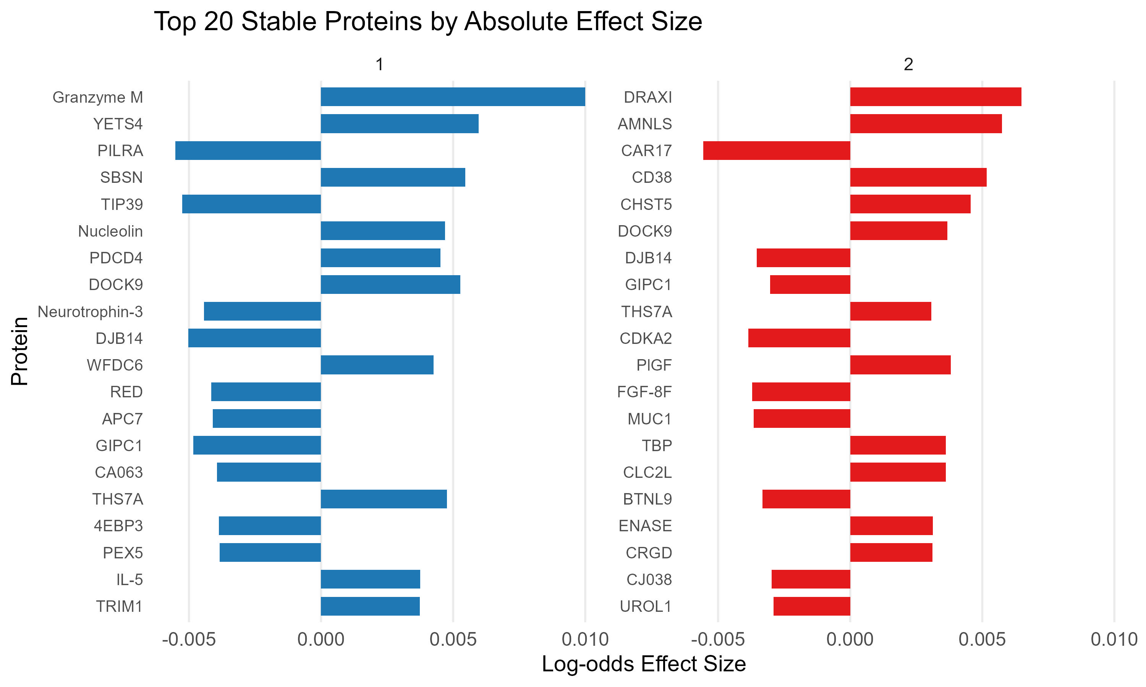
Proteins with high stability in predicting CHIP subtypes
Bootstrap procedure identified 172 proteins with high stability (selected in > 90% models)
Bar plot shows top 20 proteins ranked by absolute effect size* in models for DNMT3A and non-DNMT3A CHIP
DNMT3A CHIP
Non-DNMT3A CHIP
* Effect sizes of proteins selected with high stability were estimated by refitting a multinomial logistic regression model on the full dataset.
Unpublished data
Notes:
Extension of the CHIP protein
Protein can be important mediator and risk factors for aging conditions
for a wide range of age-related diseases

Slide 20
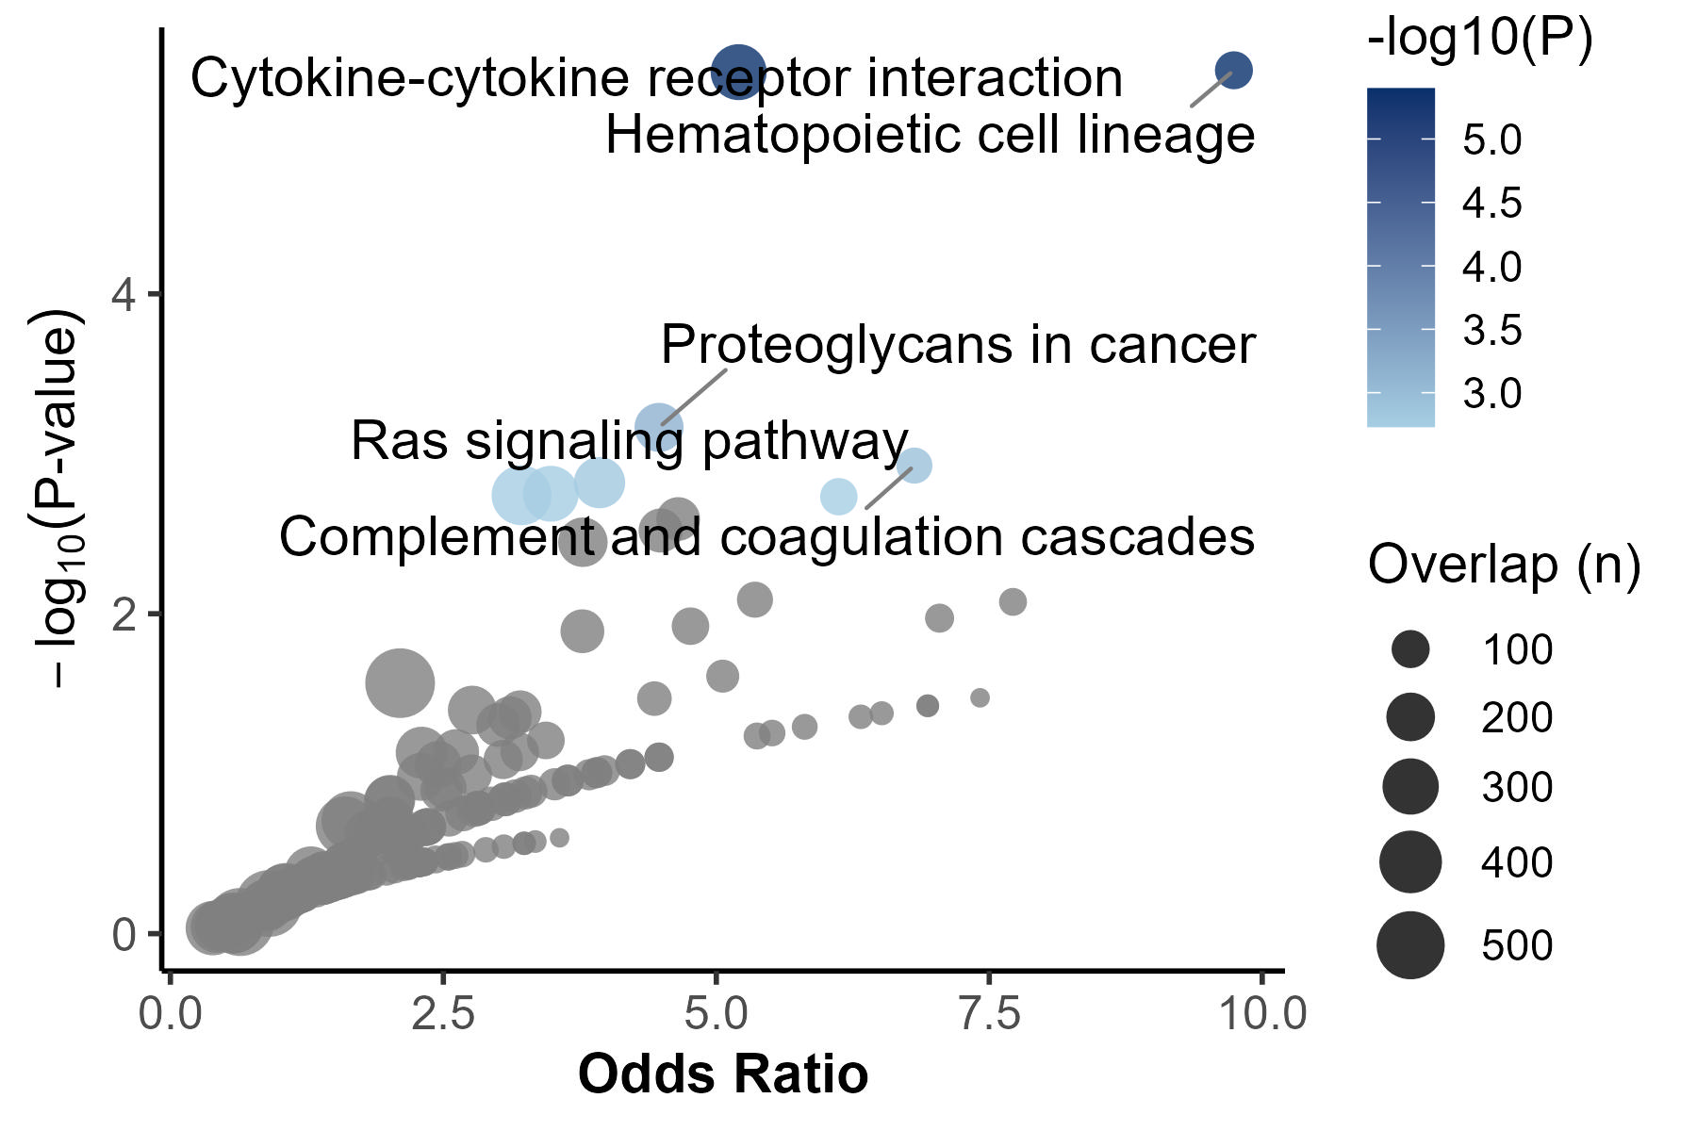
Proteins associated with CHIP in CKD enriched in inflammatory pathways
Pathway enrichment analysis based on KEGG 2021
Unpublished data

Slide 21
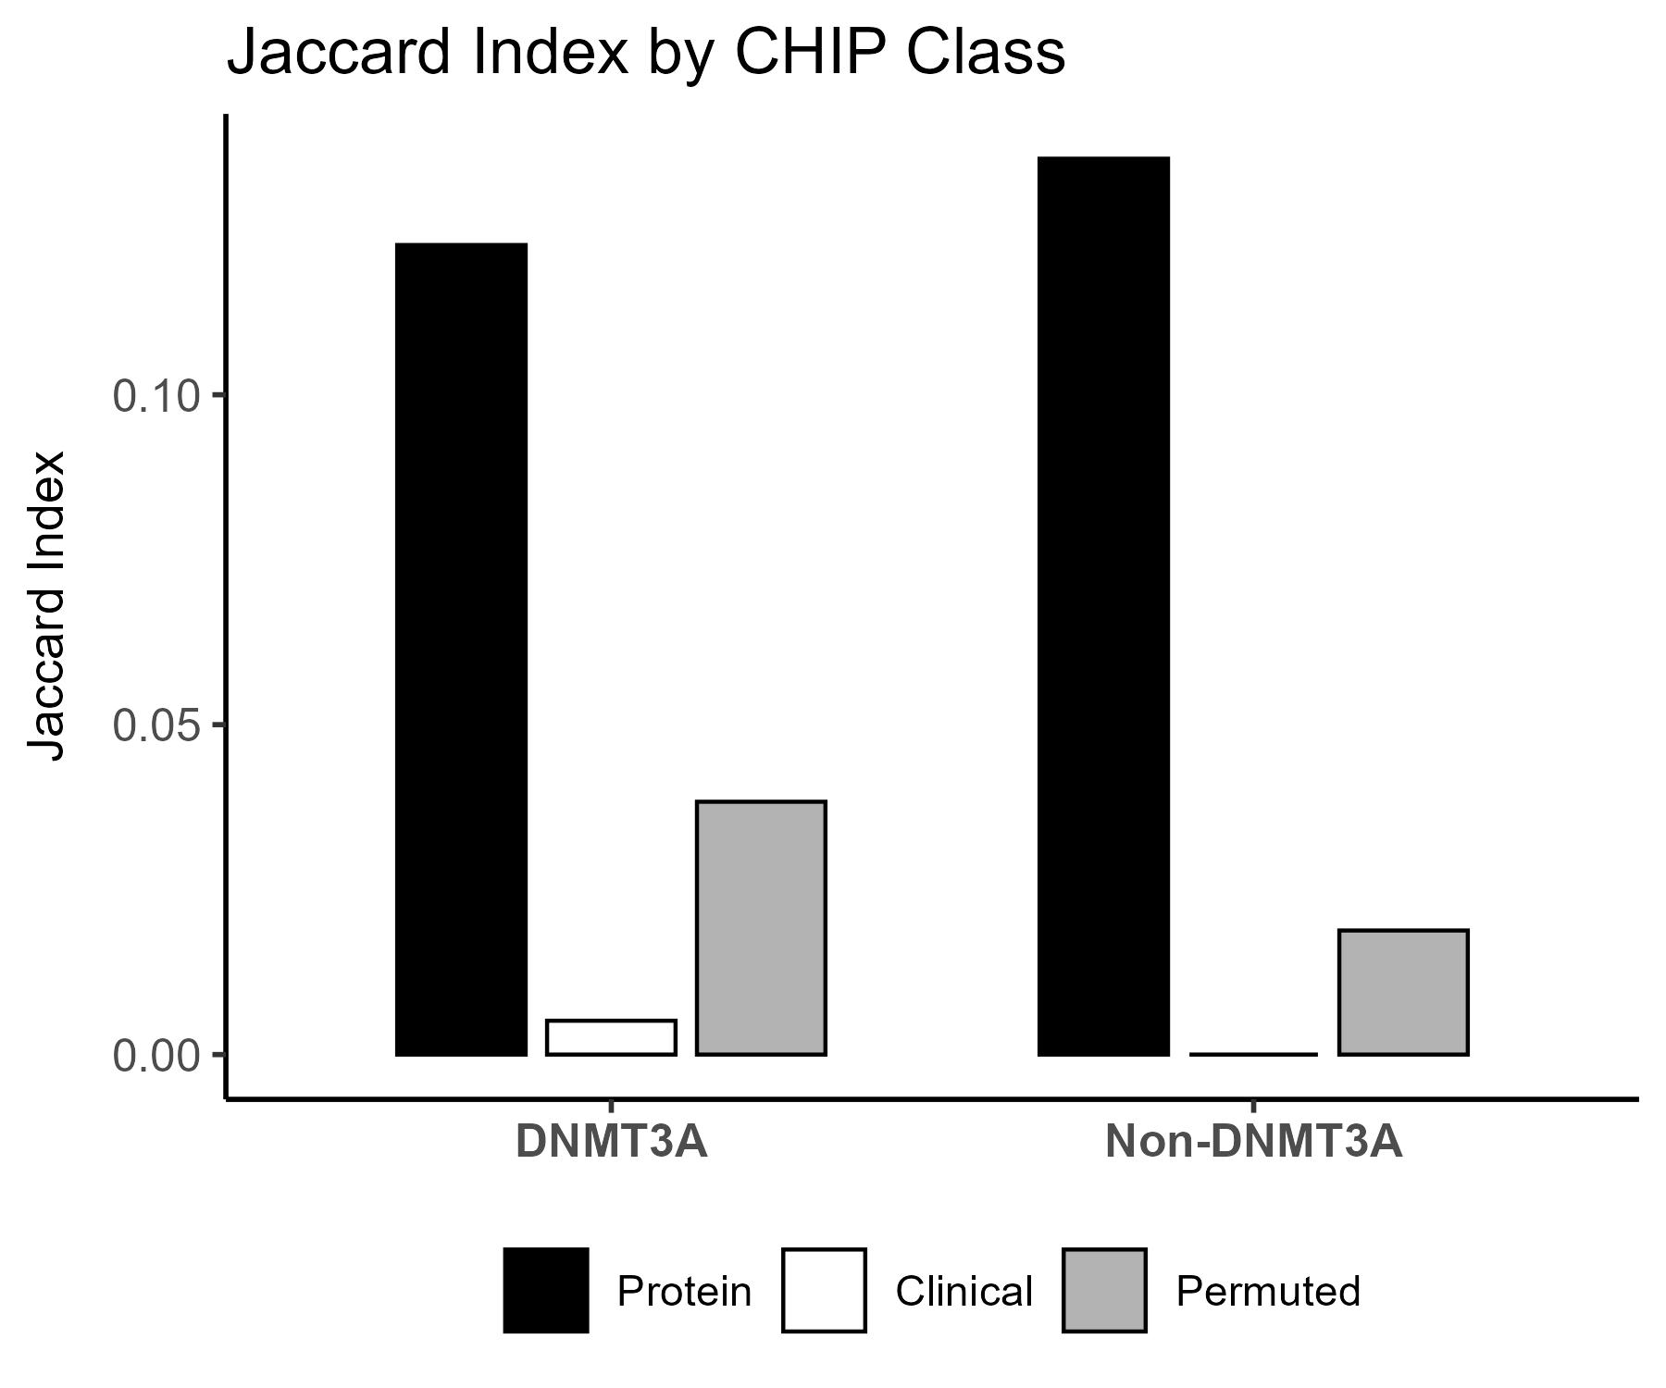
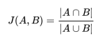
Protein signatures improve patient classification of CHIP subtypes by Jaccard Index
This estimated using a bootstrapping (OOB) approach to minimize biases
Jaccard index (JI) measures similarity of samples within the same category
JI ranges from 0–1, with 1 indicating identical lists; average JI from bootstrap results is shown.
Protein model outperforms:
basic models* (16 demographic and clinical features)
models with permuted outcomes using the same number of proteins
*Basic model: age, sex, race/ethnicity, CCID, CCID, eGFR, diabetes, hypertension, ACE/ARB, BMI, statins, HDL, LDL, total cholesterol, triglycerides, current smoking, and any CVD
Score type
Basic
Unpublished data
Notes:
CHIP protein signatures outperform in nearly unbiased evaluation
Non random information is captured in the model.

Slide 22
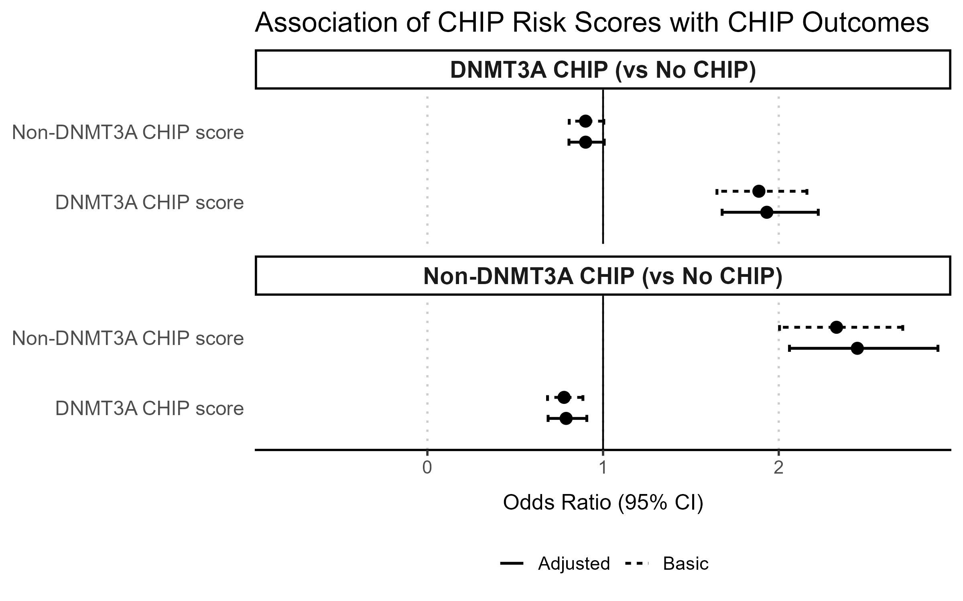
Associations of CHIP protein scores with major CHIP outcomes
CHIP protein signatures are strongly associated with CHIP subtypes, independent of demographic and clinical factors
Associations estimated through bootstrapping
Scores show specificity to CHIP subtype
*Basic model using 16 demographic and clinical variables: age, sex, race/ethnicity, CCID, CCID, eGFR, diabetes, hypertension, ACE/ARB, BMI, statins, HDL, LDL, total cholesterol, triglycerides, current smoking, and any CVD
Unpublished data

Slide 23
Summary
Single protein tests were null but penalized multinomial regression identified protein signatures of CHIP in patients with CKD
Proteins robustly associated with CHIP are enriched in aging and inflammation pathways
Protein scores are insufficient to fully differentiate patients with CHIP from those without CHIP
Protein scores associated CHIP subtypes, independent of demographic and clinical variables
What’s next:
Validate findings in independent datasets (e.g., TOPMed, UK Biobank)
Mediation analysis: CHIP –> protein/protein signature –> CVD and other clinical outcomes
Leverage longitudinal CHIP measurement to identify protein risk factors
Notes:
What’s next

Slide 24
Aging-related molecular changes in chronic diseases
Causes and consequences of clonal hematopoiesis of indeterminate potential (CHIP) in chronic kidney disease (CKD)
Epigenetic aging and brain and heart health in midlife
Notes:
Ongoing work

Slide 25
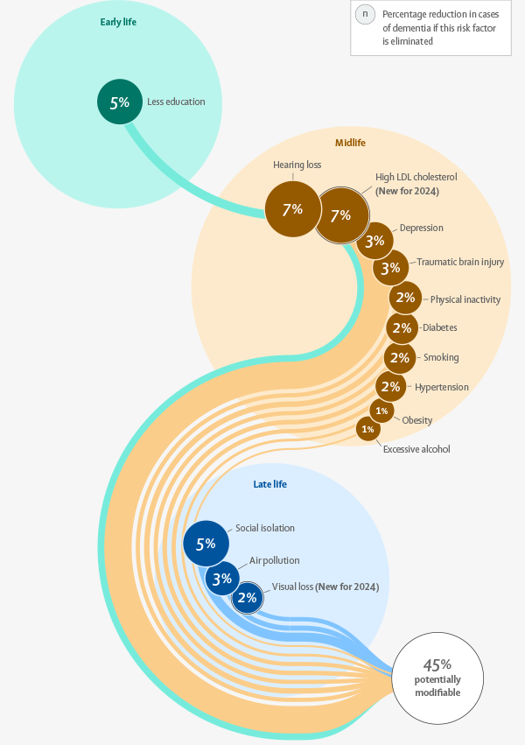
Alzheimer’s disease and related dementia (AD/ADRD)
Dementia is projected to affect 150 million people by 2050 globally
Despite recent advances, effective treatment of AD remains limited
Life-course prevention of AD
Early detection of pre-clinical cognitive decline in midlife
Livingston, Gill, et al. The Lancet (2024)
Notes:
Alzheimer's disease (AD) does have a long prodromal period, before manifestation
Early detection represented as a key task

Slide 26
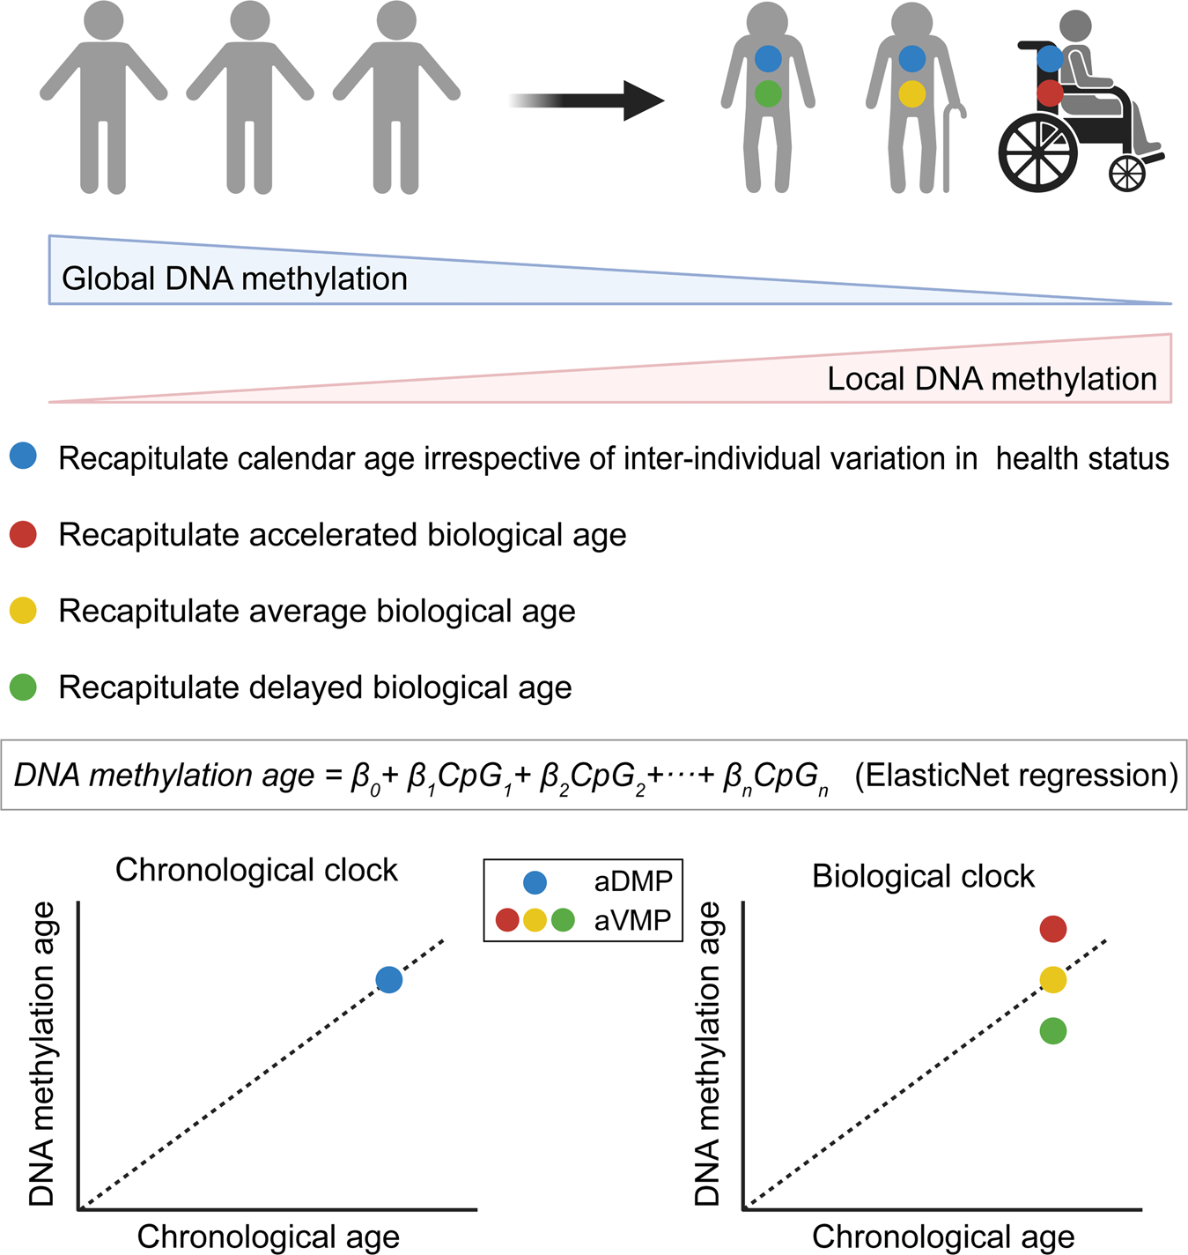
Epigenetic age acceleration (EAA)
Adverse epigenetic change is an independent and reversible cause of aging. *
Epigenetic age acceleration (EAA) - the difference between epigenetic age and chronological age
Gap: the relationship between EAA and cognition during midlife
* Yang, Hayano,. Cell. (2023)
Liu, Zhao, Yu, et al. Sig Transduct Target Ther (2023)
Notes:
Epigenetics may harbor early sign of aging

Slide 27

The Bogalusa Heart Study (BHS)
The BHS is a long-term community-based epidemiological investigation of the natural history of cardiovascular disease across the lifespan.
Childhood & Adolescence
Young Adulthood
Midlife
1975
1985
1995
2005
GWAS genotyping
2015
2025
Demographic, lifestyle, and clinical CVD risk factors (18 visits)
1973
2024
End of current
visit cycle
Current study includes up to 1,298 BHS participants who were:
Examined longitudinally, beginning in childhood
Had epigenetic data and neurocognitive tests collected at the same (current) visit

Slide 28

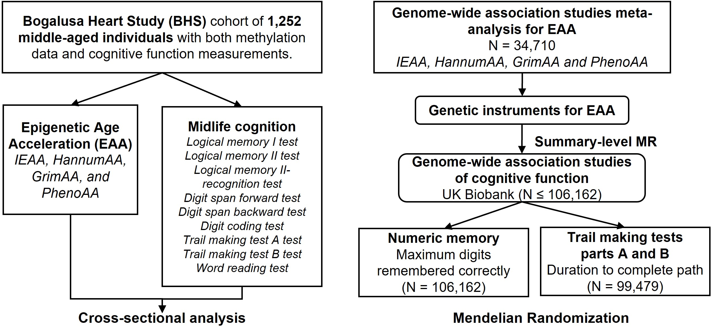
Examine the relationship between EAA and cognition during midlife
Pan*, Huang*, et al. npj Aging (2025)

Slide 29
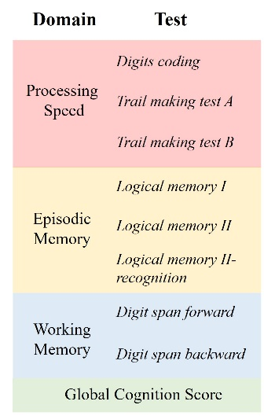
Measurement of cognition
Neurocognitive test scores were rank-based inverse normal transformed.
Domain-specific scores and a global cognitive score (GCS) were summarized from corresponding neurocognitive tests.
In both BHS and UK Biobank, Trail making tests (TMT) scores were reversed, with higher scores indicating better performance.

Slide 30
Examine the relationship between EAA and cognition during midlife
Pan*, Huang*, et al. npj Aging (2025)

Slide 31
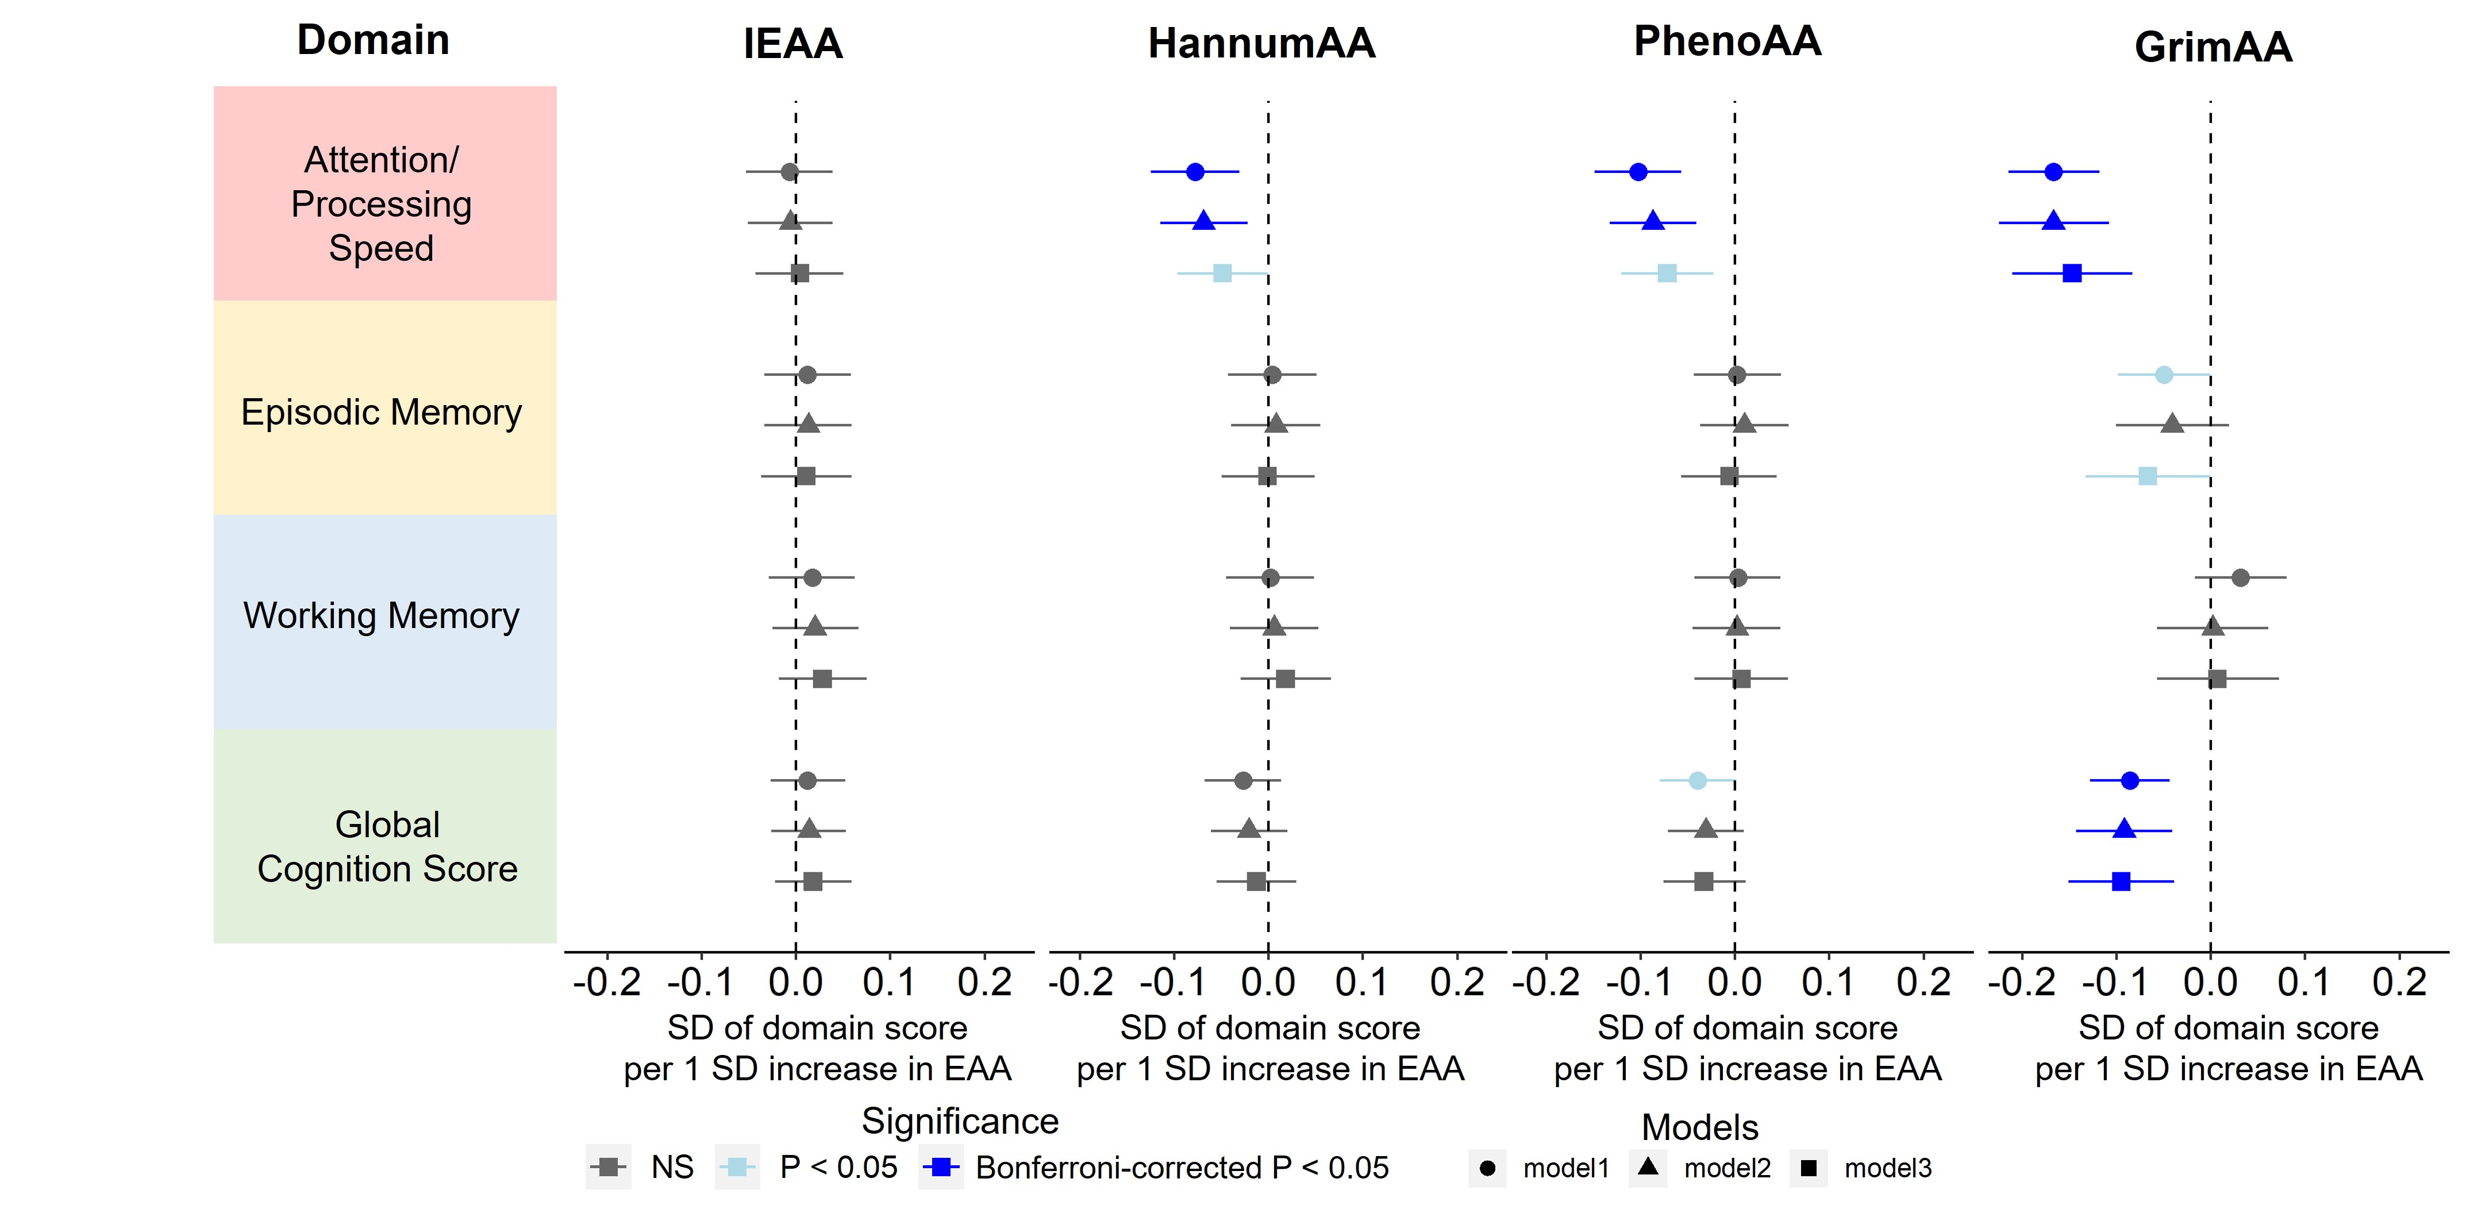
Associations between EAA and cognitive function among middle-aged BHS participants
Model 1: age, sex, race, and achieved education.
Model 2: covariables in model 1 + smoking status, alcohol consumption, and depression.
Model 3: covariables in model 2 + clinical covariables
Pan*, Huang*, et al. npj Aging (2025)

Slide 32
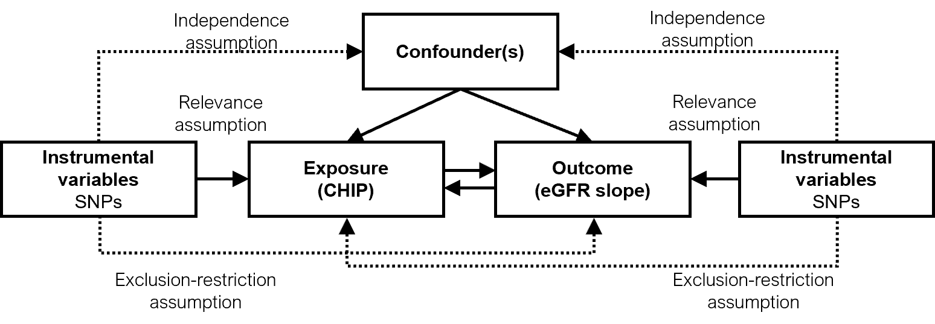
Mendelian randomization (MR) estimates for the effect of EAA on cognitive function in midlife population – the concept
(EAA)
(Cognition)
Naturally inherited genetic variants are randomly allocated at conception, mimics intervention allocation in randomized controlled trials (RCTs), minimizing confounding and reverse causation
Notes:
Next, we want to consolidate our observational findings. One technique we used is MR analysis.
This is a approach widely used in epi nowadays, for providing causal inference based on genetic data alone, mostly GWAS summary statistics data.
The concept of it is
In this study, we will find geneic instrument of XX

Slide 33
MR study demonstrated genetically predicted GrimAA was causally associated with slower processing speed
Outcome | Exposure Genetic instruments |  | Primary analysis
 |  |  | Egger intercept P | Method | Effect* (95% CI) | P
Trail making tests parts A (N = 99,479) | GrimAA 4 SNPs |  | 0.34 | IVW | -0.024 (-0.049 to 0) | .05
Trail making tests parts B (N = 99,477) | GrimAA 4 SNPs |  | 0.54 | IVW | -0.022 (-0.059 to 0.015) | .25
Numeric memory (N = 106,162) | GrimAA 4 SNPs |  | 0.55 | IVW | 0.97 (0.94 to 1.01) | .14
CI, confidence interval; IVW, inverse variance-weighted; SNP, single nucleotide polymorphism.
* Effect is per 1-year increase of EAA. Effects for trail making tests are β coefficients based on the GWAS using inverse rank normal transformed duration to complete path. Effect for numeric memory is odds ratio based on the GWAS using maximum digits remembered correctly that is modeled as ordered categorical variable
Pan*, Huang*, et al. npj Aging (2025)
Notes:
In the MR study, we tested EAA with 3 cognitive tests performed in the BHS, we able to identify a potentially causal association between GrimAA and Trail making tests, a test represents cognitive domain of processing speed.

Slide 34
Summary
In a cohort of 1,252 middle-aged adults, individuals with increased EAA, particularly GrimAA, exhibited lower processing speed and global cognition, independent of known risk factors
MR results support the relationship between GrimAA and processing speed
This study supports EAA may be suitable early biomarkers for midlife cognitive decline
What’s next:
Longitudinal association between EAA and cognition
Epigenetic signatures beyond EAA

Slide 35
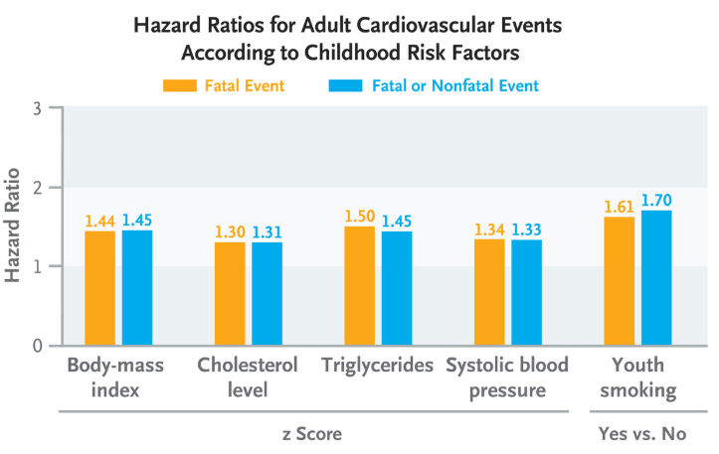
Childhood Cardiovascular Risk Factors (CVRFs)
Childhood CVRFs are predictive of midlife subclinical and clinical CVD events
Partially independent of adult level (Childhood BMI)
Midlife CVRFs
Childhood CVRFs
Midlife subclinical and clinical CVD
Gap: Childhood data is often unavailable when assessing adult risk
Jacobs DR Jr el al. N Engl J Med.
Li S, Chen W, Srinivasan SR, et al. JAMA.
Kartiosuo, Noora, et al. JAMA Network Open (2024)
Notes:
A growing list of evidence have suggested the importance of childhood CVRF on adult heart health
The most recent large-scale study i3C, provide novel evidence that childhood predicts midlife CVD
More importantly, this associated is partially independent of adult level
A recent report from the I3c, showed that childhood BMI played nearly as important a role as adulthood BMI
Despite the important of Childhood CVRF. Childhood data is often unavailable when assessing adult risk

Slide 36

Objective
This study aimed to identify epigenetic signatures reflecting cumulative childhood CVRF burden and assess their associations with subclinical cardiac structure and CVD in midlife.
Midlife CVRFs
Epigenetic signature of childhood CVRFs
Childhood CVRFs
Midlife subclinical and clinical CVD

Slide 37
The Bogalusa Heart Study (BHS)
Childhood & Adolescence
Young Adulthood
Midlife
1975
1985
1995
2005
GWAS genotyping
2015
2025
Demographic, lifestyle, and clinical CVD risk factors (18 visits)
1973
2024
End of current
visit cycle
Current study includes up to 1,213 BHS participants who were:
Had repeated childhood (aged 4-17 years) measures of clinical CVRFs. The cumulative burden of each childhood CVRF was summarized as an area under the curve (AUC) estimate
Had epigenetic data measured during midlife (2013-2016 visit cycle)
Notes:
Our study population, the Bogalusa Heart Study is…

Slide 38
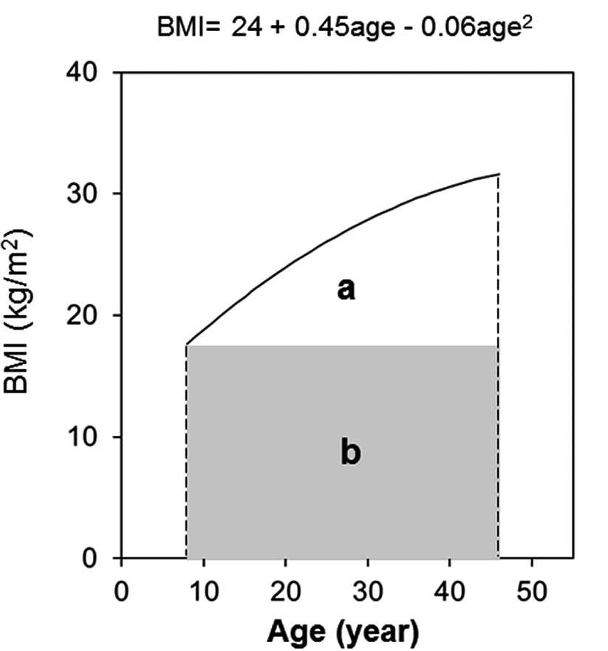
Childhood burden of CVRFs
Childhood CVRFs
BMI
Systolic blood pressure (SBP)
Low-density lipoprotein cholesterol (LDL-C)
Triglycerides (TGs)
Glucose
Cumulative childhood burden of CVRFs
Estimated as the area under the curve (AUC) from growth curves of repeated CVRFs measured during childhood (<18 years)
Total AUC can be considered a measure of a long‐term cumulative burden
Cumulative childhood burden of CVRFs
0
3
8
12
16
20
Age (Year)
Modified from Liu Y, et al.. J Am Heart Assoc. 2020
Notes:
This slides shows how the cumulative childhood burden of cardiovascular risk factors, were estimated in the BHS.
To leverage repeated childhood measurements of CVD risk factors, early life measurements were individually summarized as an area under the curve (AUC) estimate for each participant using methods developed specifically for the BHS and employed extensively in this cohort
Cumulative burden is estimated using the area under the curve (AUC) from cubic growth curves of these repeated measurements during childhood.
The AUC represents long-term exposure to risk factors over time. In the graph, sections 'a' and 'b' illustrate the total cumulative burden, showing how risk factors accumulate throughout childhood.

Slide 39
Midlife subclinical CVD measures
Midlife subclinical cardiac structure
left ventricular (LV) mass index (LVMI)
relative wall thickness (RWT)
left ventricular geometry (LVG)
Midlife subclinical atherosclerosis
Carotid intima media thickness (cIMT)

Slide 40

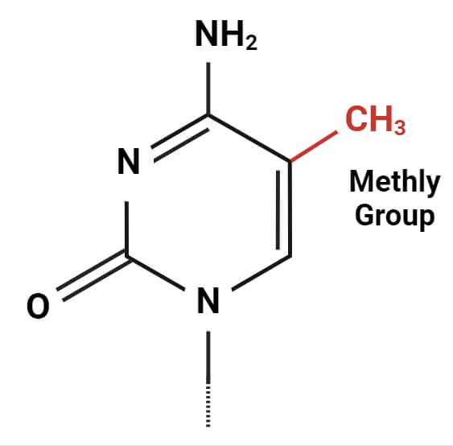
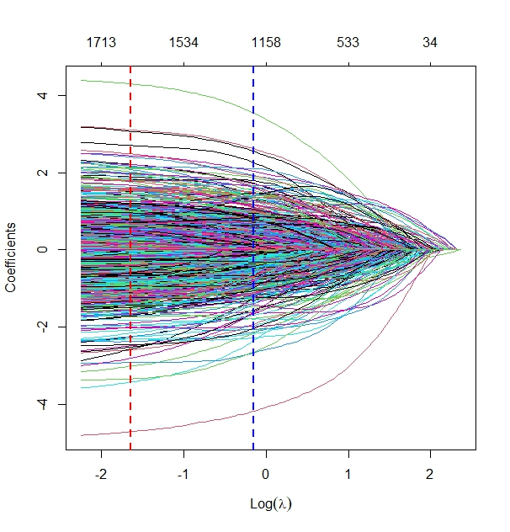
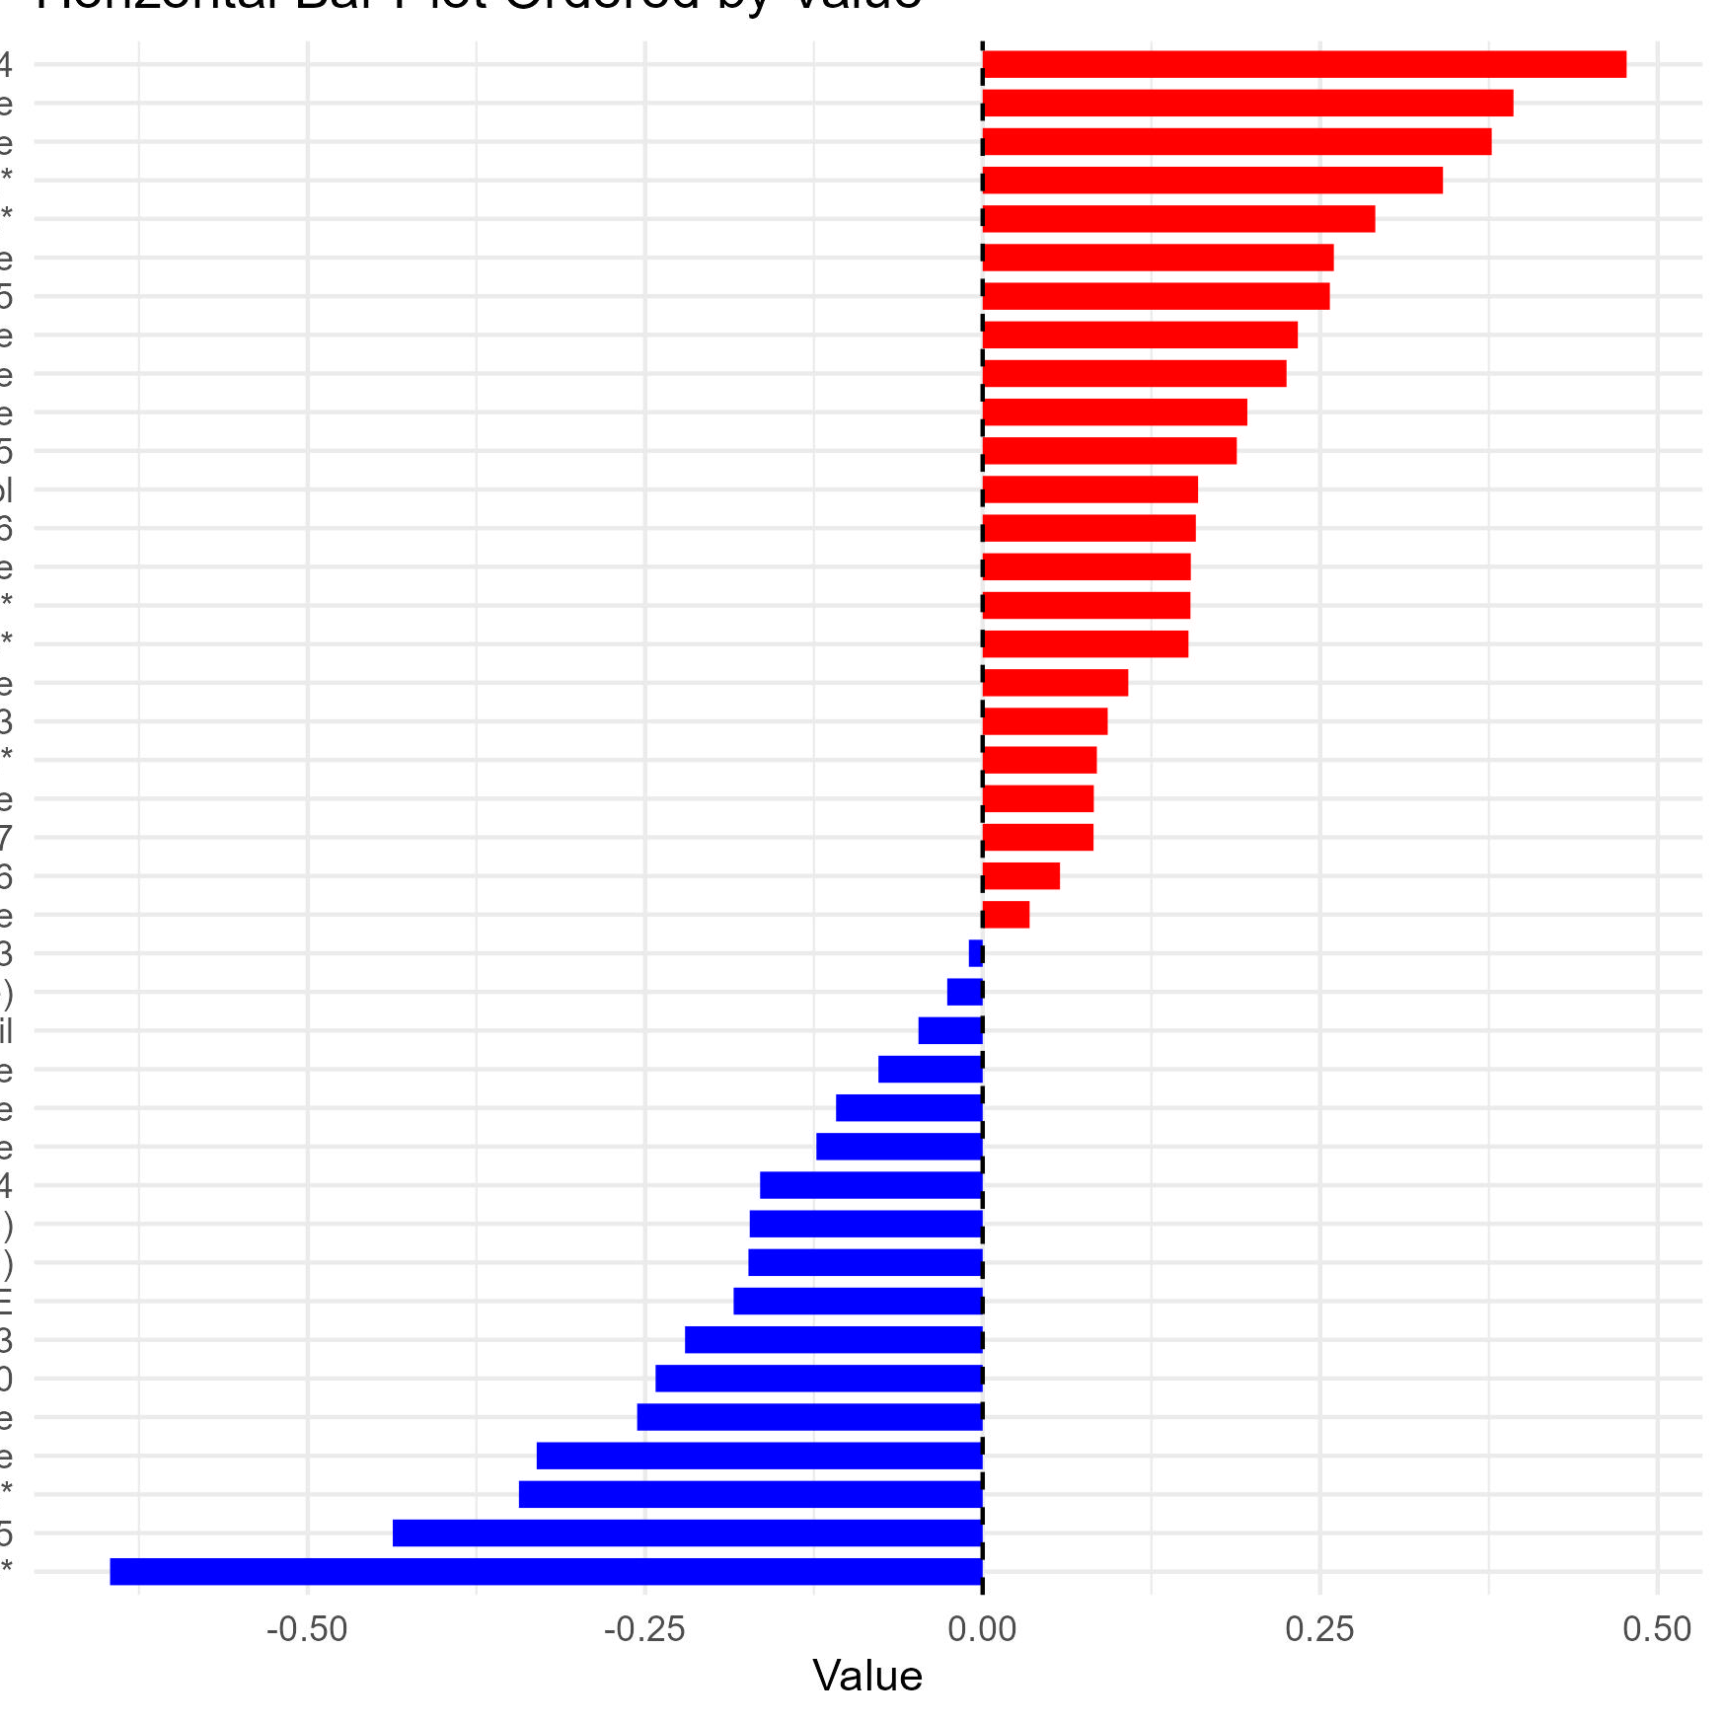
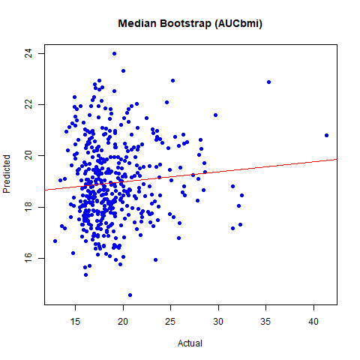
Construct metabolomic signatures for each childhood CVRF burden
Training Set
Construct signature
Elastic net regression
Parameter selection
(10-fold cross-validation)
~70%
BHS
Participants
N= 1,213
Pre-selected independent CpG = 15,113
Bootstrapping
Test Set
Apply signature
Performance evaluation
Association with subclinical CVD measures
~30%
Model training
Signature
Testing
Results aggregation
Signature of
Childhood BMI burden
1,671 CpG sites
Corr.coef=0.11
Unpublished data
Notes:
This slide shows the process of constructing epigenetic signatures for childhood CVRF burden using 1,213 BHS participants.
Not only BMI, but LDL, triglycerides.

Slide 41
Associations between epigenetic signatures of childhood BMI burden and midlife subclinical cardiac structure
 |  |  | Model 1 |  |  | Model 2
 |  |  | Effect | P |  | Effect | P
 | LVMI |  | 0.85 (2.45) | 0.56 |  | 0.63 (2.49) | 0.57
 | RWT |  | 0.001 (0.002) | 0.70 |  | 0.0002 (0.002) | 0.74
 | LVG | Normal | ref |  |  | ref
 |  | Concentric remodeling | 2.8 (0.3,4.9) | 0.53 |  | 2.9 (0.3, 5.1) | 0.53
 |  | EH | 4.2 (1.2,9.2) | 0.02 |  | 4.3 (1.3,8.6) | 0.02
 |  | CH | 5.7 (4.3,7.3) | 0.002 |  | 6.2 (5.4,7.6) | <0.001
Model 1: Age, sex and race
Model 2: Model 1 + midlife smoking and drinking
Unpublished data
Notes:
We examined associations between metabolomic signatures of childhood CVRF AUCs and midlife subclinical cardiac structure, including LVMI, RWT, and LVG.
The table here shows the findings from the childhood BMI burden signature, which has strongest contribution to adult CV health status.
In the table: Childhood BMI burden remains significantly associated LV Geometry (LVG): Concentric hypertrophy and Eccentric hypertrophy show strong associations in Models 1 and 2, which are demographics and midlife life style factors,
Note: Other methylation signatures, logTG show similar results that only associated with CH in two models. Other signatures of childhood burden, (not shown here) do not show significant associations with cardiac structure after adjusting for midlife CVRFs.

Slide 42
Summary
Epigenetic-based signatures capture childhood CVRF burden of BMI and triglycerides
These signatures are associated with midlife changes in cardiac structure and but not cIMT, independent of adult exposure.
These signatures show potential as surrogates when childhood exposure data is unavailable.
What’s next:
External validation
Experimental models

Slide 43


Acknowledgement
University of Illinois Chicago
Tanika Kelly
Xiao Sun
James Lash
Zhijie Huang
Brenna Kirkpatrick
Xiang Li
Yixi Sun
Brian Layden
Tulane University SPHTM
Lydia Bazzano
UT Southwestern Medical Center
Changwei Li
Jiang He
Johns Hokins University
Dan Arking
Rush University
David Bennett
Pennington Biomedical Research Center
Owen Carmichael
Study participants and staff of
The Bogalusa Heart Study
Chronic Renal Insufficiency Cohort
Questions, feedback, or collaborations?
Funding source
Contact
Yang Pan, PhD
Email: yangpan5@uic.edu
R00 AG083214 (2025-2028)

Slide 44
Thank you for your attention!

Slide 45
No significant difference in the CHIP-CVD association based on baseline eGFR, diabetes status, or race
Pan, Vlaesschaert et al. J Am Soc Nephrol. 2025

Slide 46
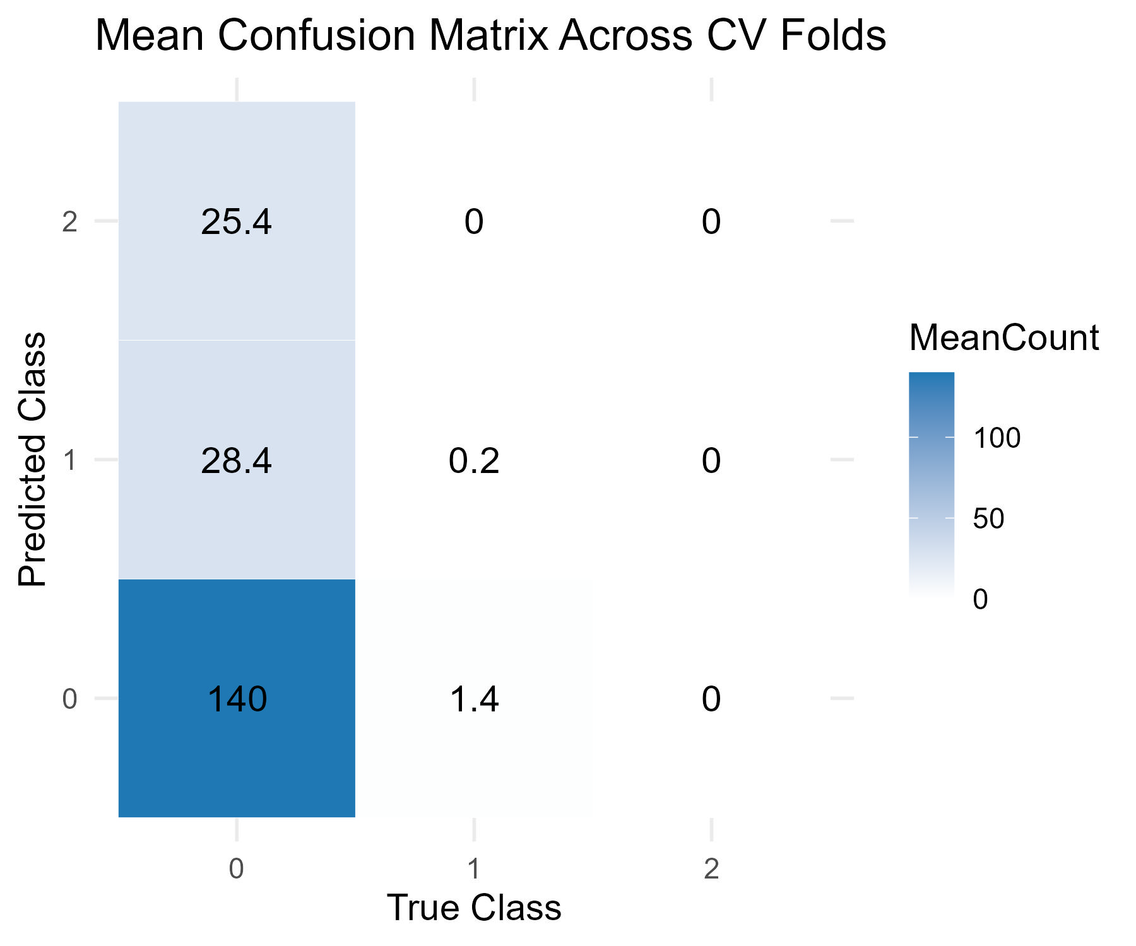
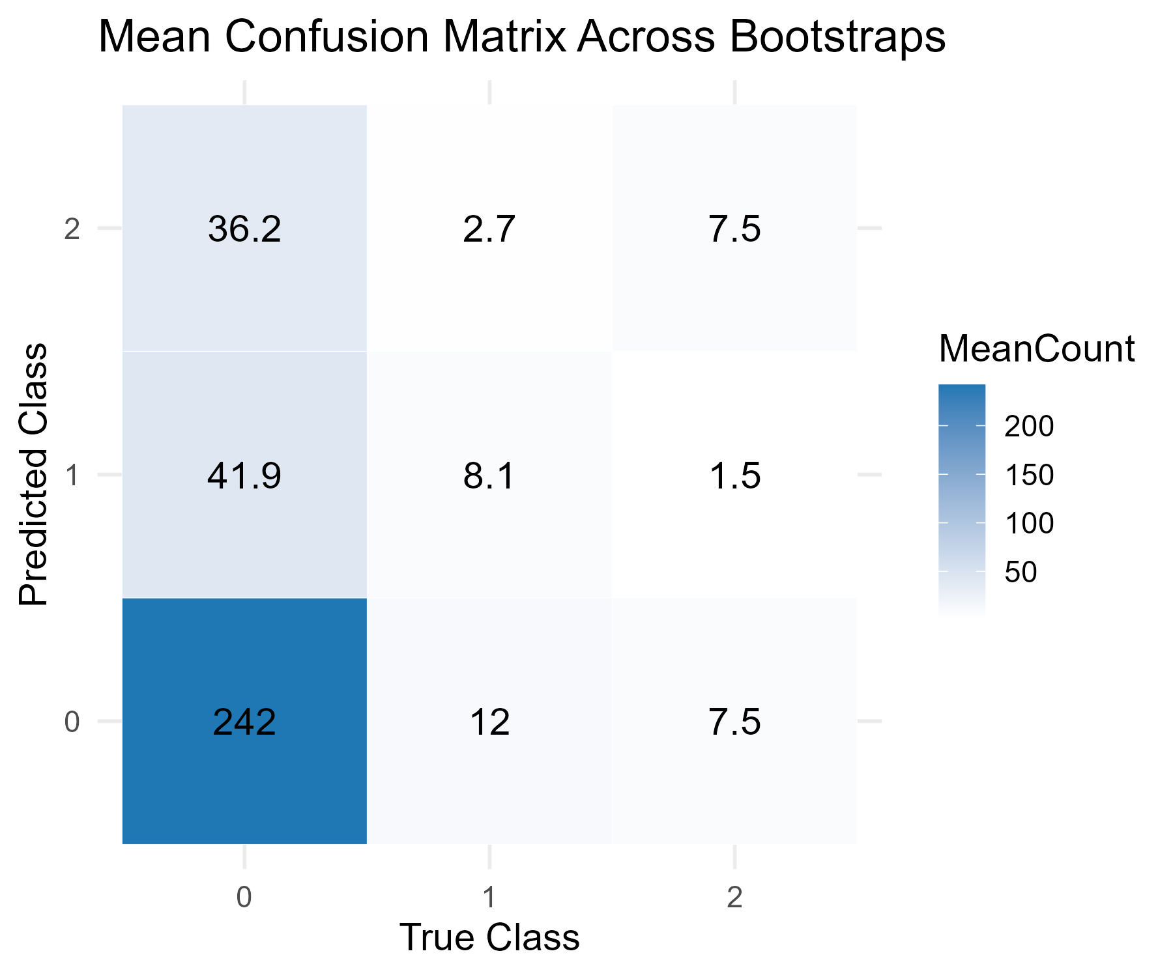
Protein signature scores improve CHIP classification beyond demographic and clinical variables
Classification matrices showing predicted vs. true patient counts for each CHIP outcome
Numbers averaged from k-fold cross-validation or bootstrap results
Mean classification matrix for basic models*
Mean classification matrix for protein models
Non-DNMT3A
Non-DNMT3A
DNMT3A
DNMT3A
Predicted Class
Predicted Class
NoCHIP
NoCHIP
NoCHIP
DNMT3A
Non-DNMT3A
NoCHIP
DNMT3A
Non-DNMT3A
True Class
True Class
*Basic model using 16 demographic and clinical variables: age, sex, race/ethnicity, CCID, CCID, eGFR, diabetes, hypertension, ACE/ARB, BMI, statins, HDL, LDL, total cholesterol, triglycerides, current smoking, and any CVD
Unpublished data
Notes:
Admittedly, majority CHIP cases are not correctly predicted, even this is a 0/1 improve from using demographic/clinical variables

Slide 47
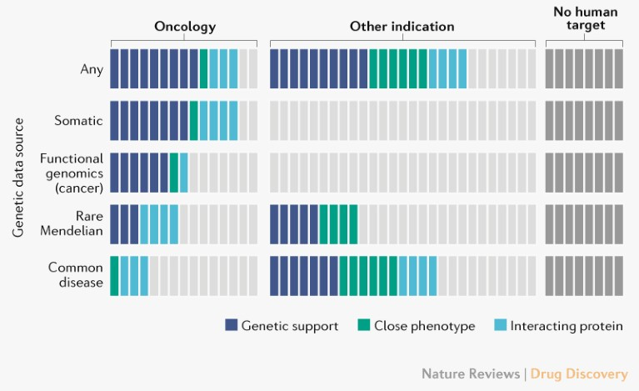
Human genetic and genomic evidence improves success rate of drug development
Drugs with genetic support have over twice the success rate in development¹
Human genetics evidence supports two-thirds of the 2021 FDA-approved drugs²
1. Minikel et al. Nature 2024
2. Nat Rev Drug Discov 2022

Slide 48
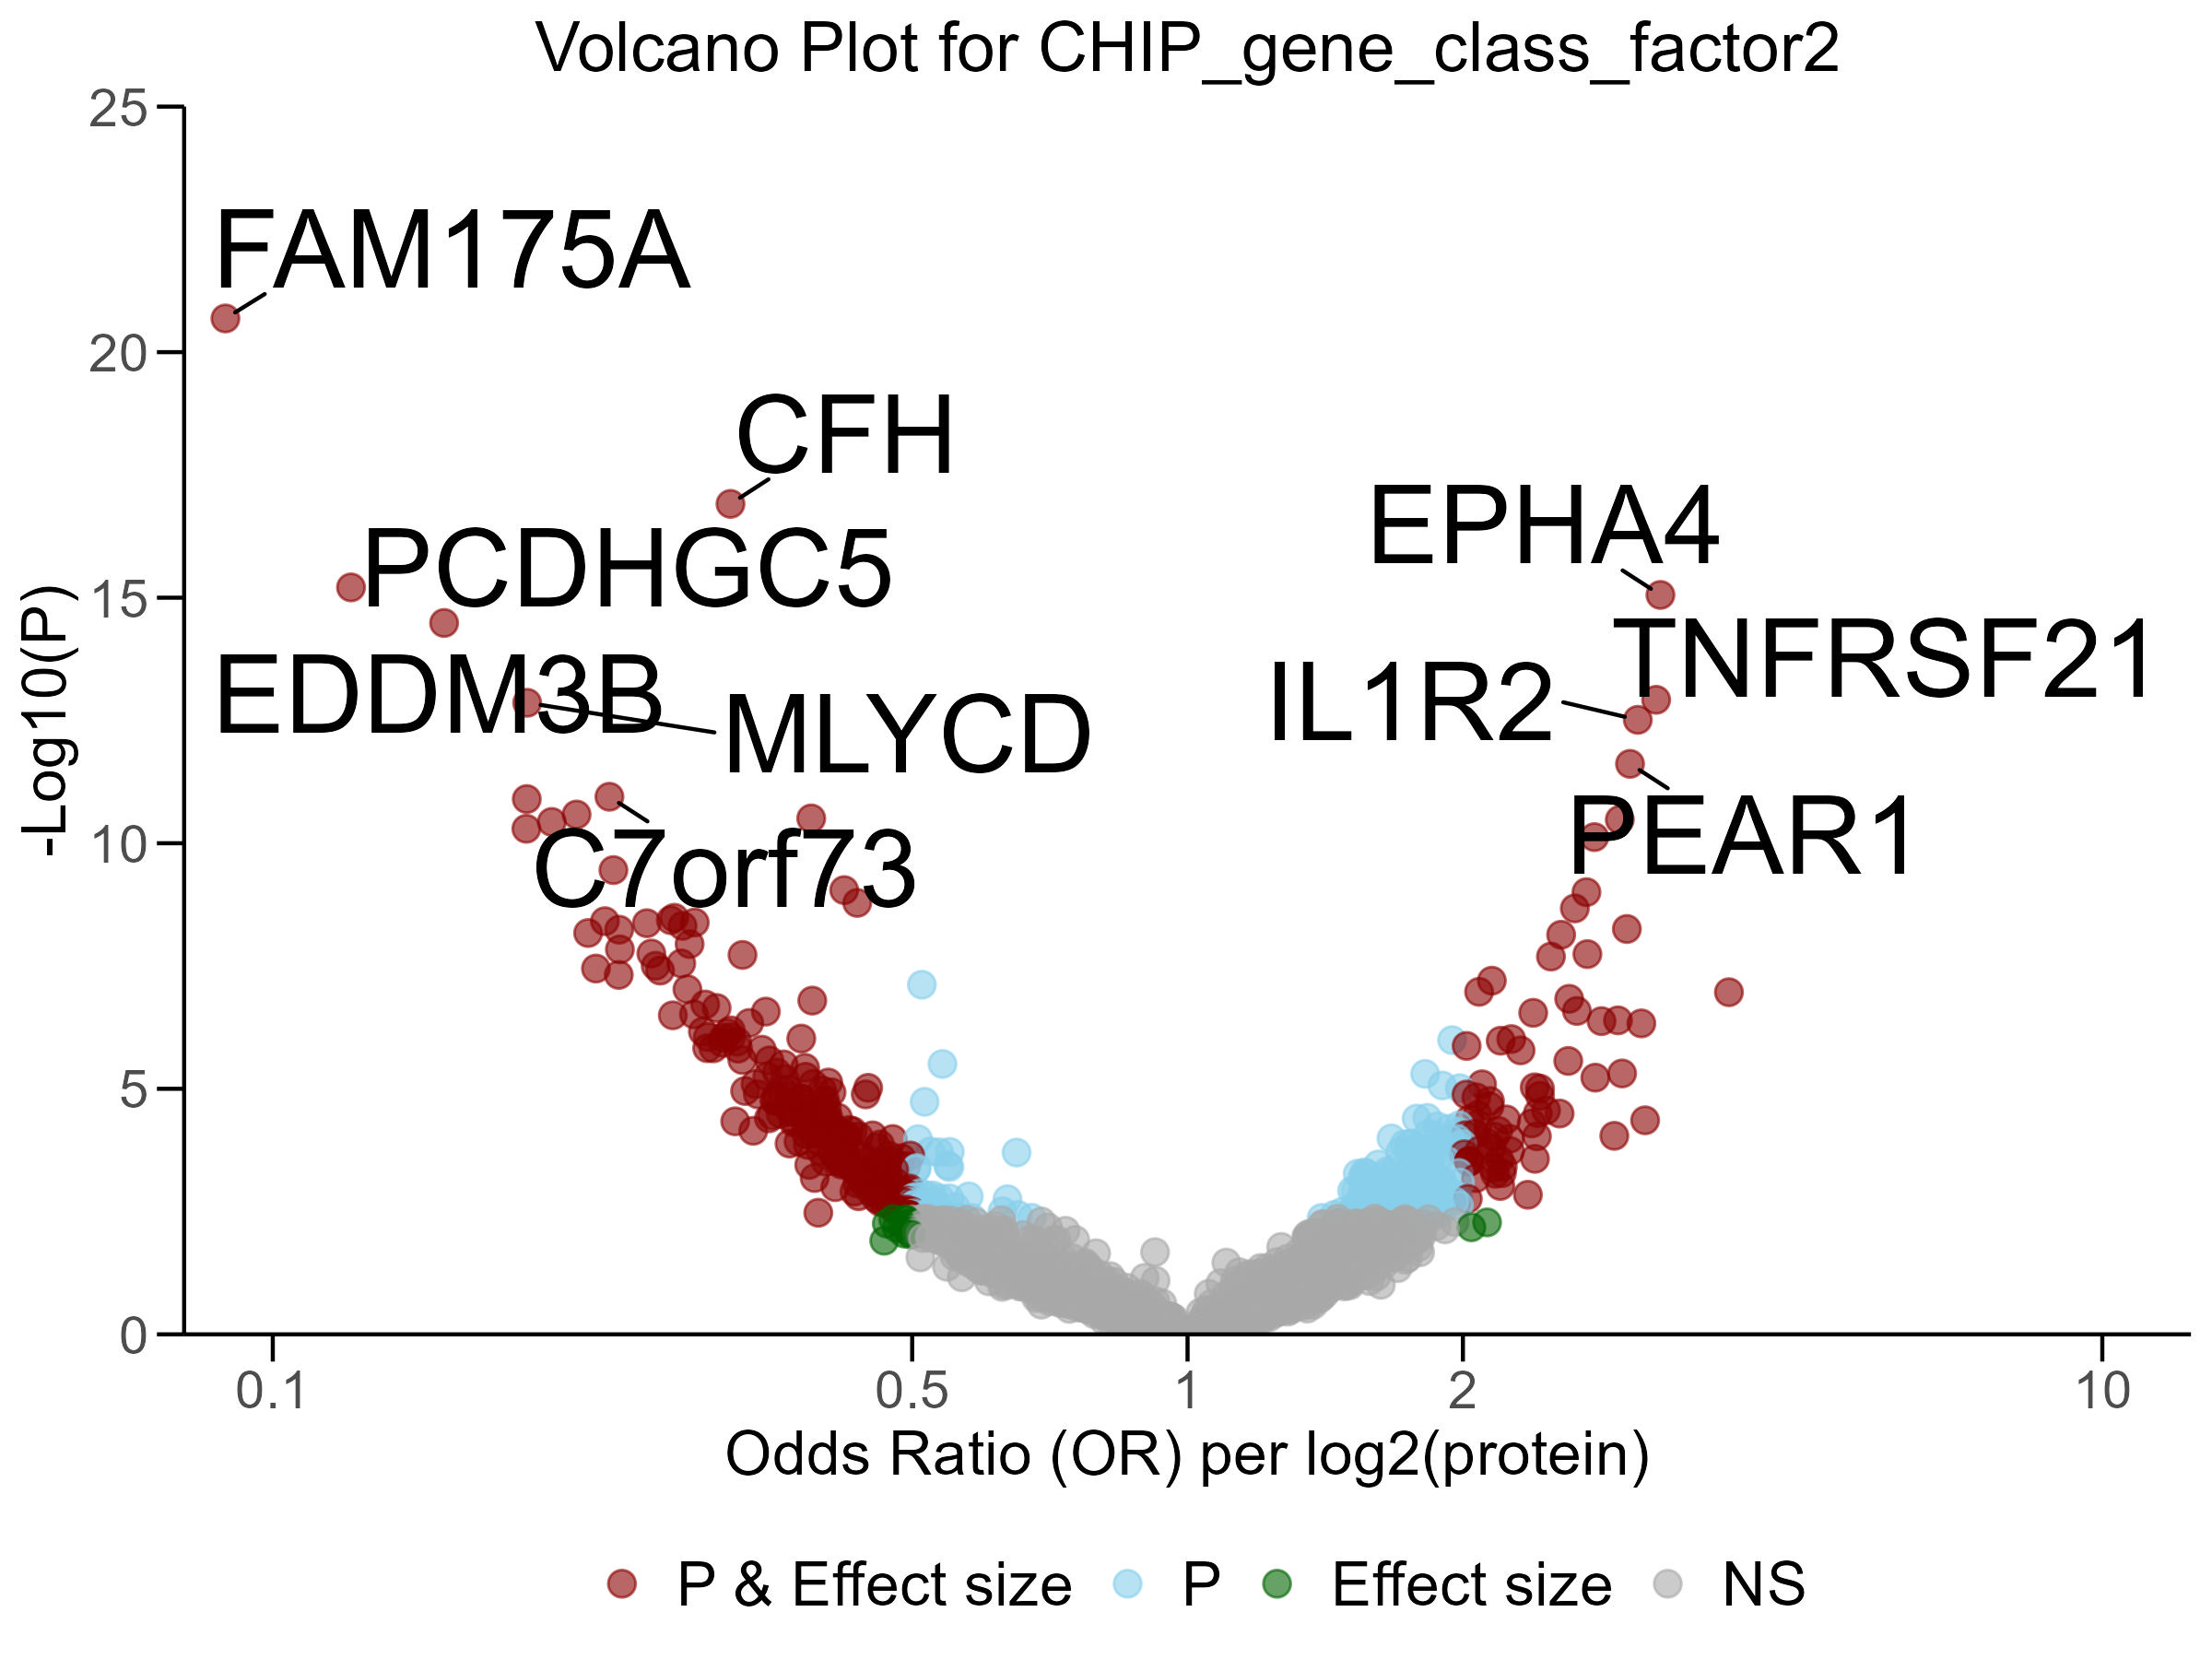
Associations between plasma proteins and CHIP in CKD patients
Protein risk factors improve disease risk prediction
Protein risk factors for CHIP may inform early prevention for a wide range of diseases
Study population: longitudinal CHIP measured at two time points, proteomics at baseline (CRIC, n=991)
Of 4,831 proteins, 481 were cross-sectionally associated with non-DNMT3A CHIP.
22 proteins were prospectively associated with CHIP incidence over 3 years (n = 310).
Proteins associated with non-DNMT3A CHIP in CKD patients
Unpublished data
Notes:
Extension of the CHIP protein
Protein can be important mediator and risk factors for aging conditions
for a wide range of age-related diseases

Slide 49

Outer loop (Bootstrapping )
Original data
a | b | c | d | e | f | g | h | i | j
Training data
Test data
i | c | h | c | b | g | j | b | f | h
a | d | e
d | f | a | j | b | h | d | i | e | a
c | g
Inner loop (K-fold validation)
Test data
Training data
Optimized parameters
$$⋮$$

